Slide 1
WINLINK 101
EMAIL WITH A RADIO TWIST
APRIL 2016
John K7TY

Slide 2
OBJECTIVES
Why digital messaging
Know what hardware you’ll need
Configuring the software
Using it
Troubleshooting
Digital messaging = Winlink = RMS Express

Slide 3
WHY DIGITAL MESSAGING?
Served Agencies want “email” messaging
Speed, accuracy, reliability of messages
File transfers
“no pain” logging
OEM STANDARDIZED ON WINLINK
RMS Express is the software
Windows-only

Slide 4
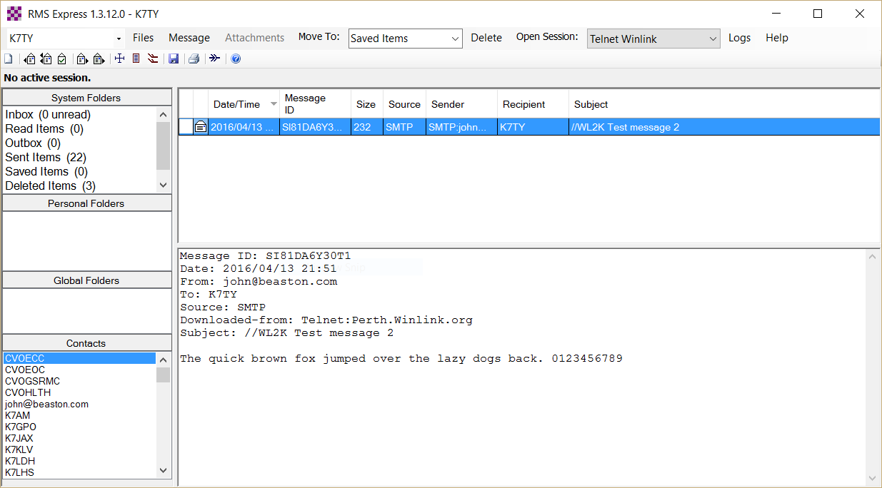
RMS EXPRESS DOES WINLINK
Looks and feels like old Outlook Express

Slide 5
4 WAYS TO MESSAGE
telnet – when you have internet
VHF – local connectivity (1200/9600)
HF – Winmor (sound card based 300)
HF – Pactor (expensive modem 1200)
Also Winlink webmail but it’s terrible….

Slide 6
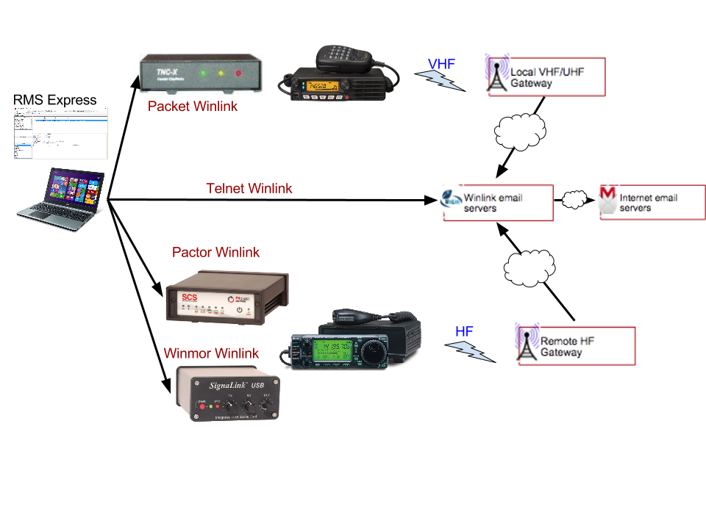

Slide 7
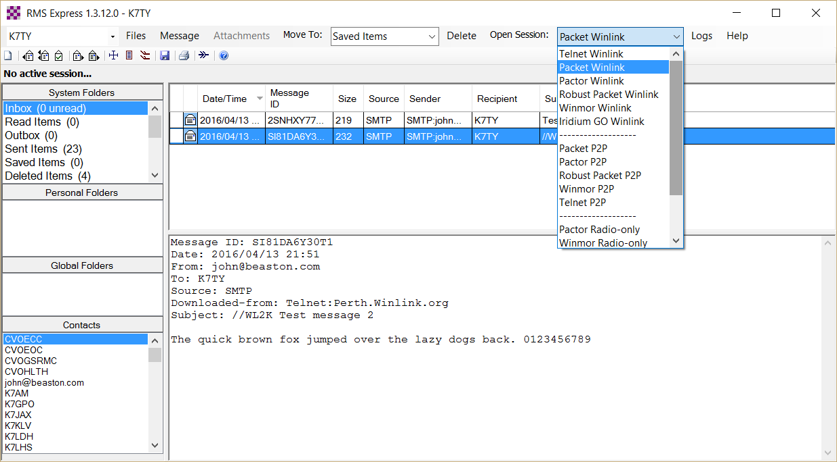

FLOW CHART
TELL RMS-EXP WHICH TO USE
Select then “Open Session”

Slide 8
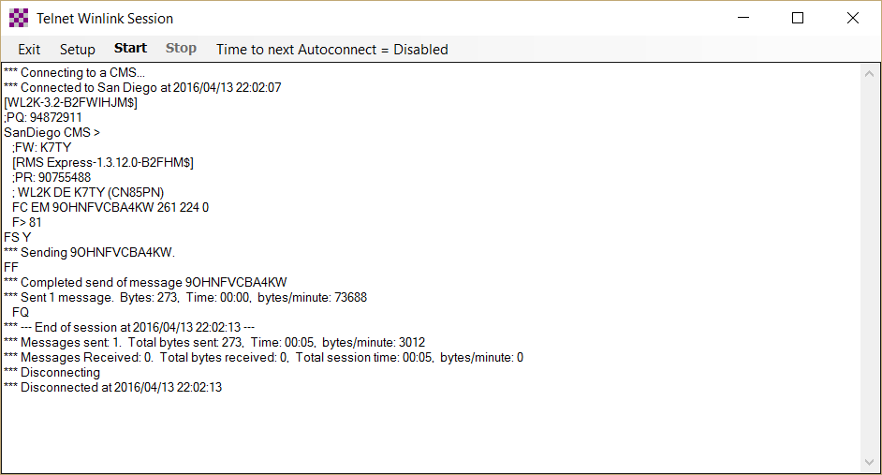
Telnet Winlink
“Start”

Slide 9
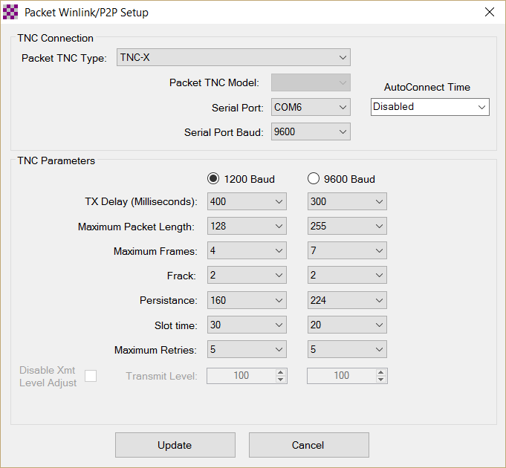
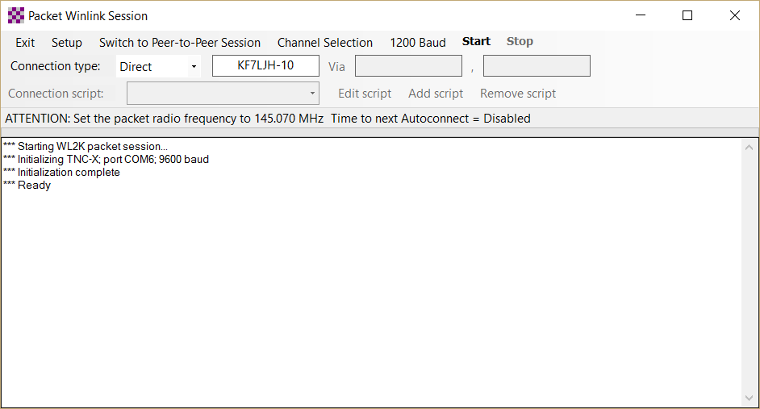
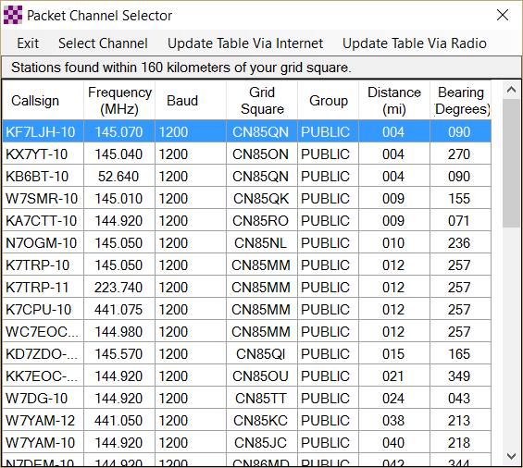
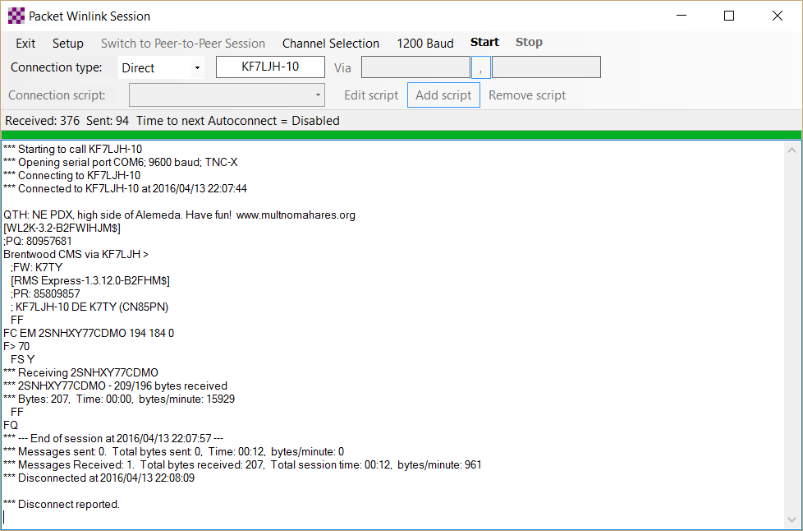
1
2
TNC SETUP
3
GATEWAY SELECTION
4
Packet Winlink

Slide 10
Update via Internet
Start
Channel/Gateway
Selection
TNC Setup
Packet Winlink

Slide 11
HOW DO I START?
Establish winlink account by sending an email through the system
<callsign>@winlink.org
Can use telnet for initial email
Single account for HF, VHF, Telnet, Webmail
Accounts purged after 400 days of inactivity

Slide 12
HOW DO I USE IT?
Like any email account
Spam filter
  Only emails you’ve sent to can send you emails
  Filter is bypassed by starting subject with “//WL2K”
NOT SECURE!
  No password required on RF
  Spoofing another address is easy

Slide 13
ARES WINLINK OPERATIONS
Drills/Incidents
  Primary gateway, K7MCE-10, 145.070, 1200baud
  All gateways forward to same winlink system, can use any gateway
  If internet is lost, K7MCE-10 will switch to local delivery mode
    Works just like normal mode, easier than p2p, relays
    No internet forwarding
  HF pactor at county, no VHF-HF forwarding. Yet.

Slide 14
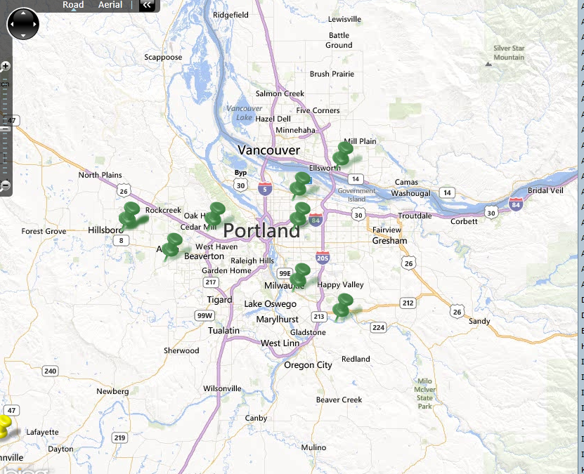
LOCAL GATEWAYS
K7MCE-10 145.070
K7GJT-10 144.940
KA7CTT-10 144.920
WC7EOC-10 144.980
N7OGM-10 145.050
N7AAM-11 145.040
W7SMR-10 145.010
KF7LJH-10 145.070

Slide 15
TROUBLESHOOTING
TNC TO COMPUTER
  USB DRIVERS (FTDI)
  BAUD RATE (9600)
  TERMINAL PROGRAM
TNC TO RADIO
  CABLING (PTT, AUDIO)
  TNC LEDS
  LISTEN ON SEPARATE RADIO
GATEWAY CONNECTION
  TRY SEVERAL FROM THE LIST
  ANTENNA PLACEMENT
  POWER

Slide 16
KUDOS
Thanks for responding to a Winlink announcement of this meeting
  W7OW - Julie
  AE7ZQ – Rochelle
  KC0CRD – James
  K7JCK – Jim
  WA7FWC – Joe
  KE7QPV – Brian
  W7ELI – Eli
  N7MWS - Matt
  KK7DEB - Deb
  KG7VQV – Gwen
  KG7EMV – Marino
  W7SRH – Steve
  KG7GCQ – Eric
  N7LF – Joel
  AE7XP - Michael
37% of MCARES members have a winlink.org address

