Slide 1
Multnomah ARES
Soundcard modes for fun and profit
and emergency services

Slide 2
Packet (RMS) vs soundcard modes
Packet
  Works like email
  Simple, reliable hardware
  National, state ARES standard
  Digipeater support
  Requires strong signal
  Slow (5-10kb file limit)
Soundcard modes
  Works with poor signals
  Huge number of hardware setup options
  (can be) As much as 4-10x faster
  Realistic file/image transfer
  Fussy
  Complicated setup

Slide 3
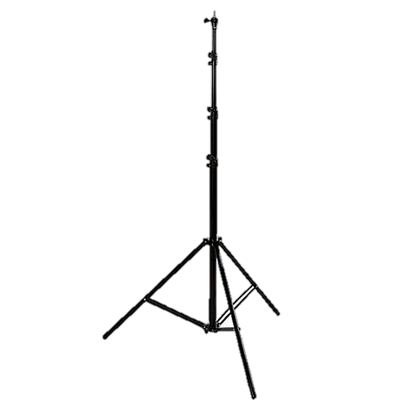
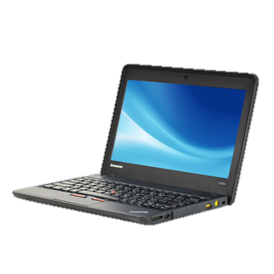
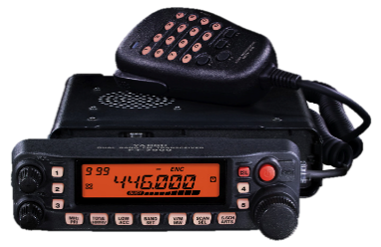
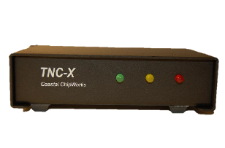
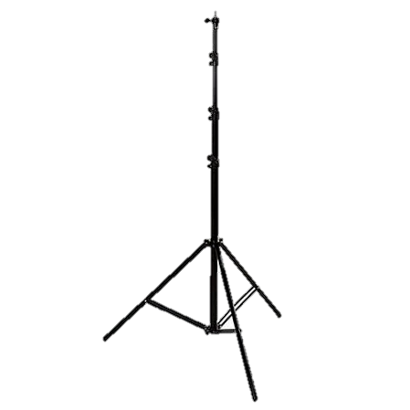

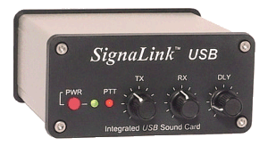
Packet (RMS) vs soundcard modes
USB/Serial
TNC
ASCII Text
Audio
Presents as a com port
Digital Interface
USB
Digital data
Audio
Presents as a new soundcard (mic and speaker)

Slide 4
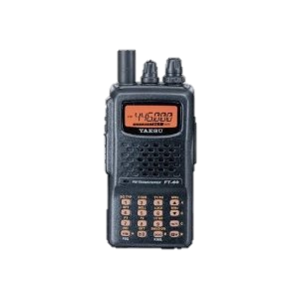
Other Soundcard hardware setups
Digital Interface
USB
Digital data
Audio
Presents as a new soundcard (mic and speaker)

Slide 5
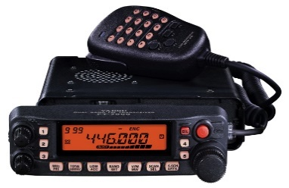
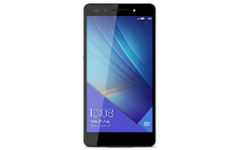
Who needs an interface?
“Acoustic coupling”
Hold the mic up to the laptop or smartphone’s speakers
Works well with “forgiving” modes like SSTV and MT-63
Not great for high-speed modes or digital image transfer

Slide 6
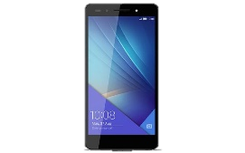
Soundcard Applications
Hundreds of soundcard applications
90% are for HF bands
ARES is looking at three
  FLDigi (mac or windows)
  MMSSTV / MultiMode
  EasyPal (windows)
More and more smartphone apps

Slide 7
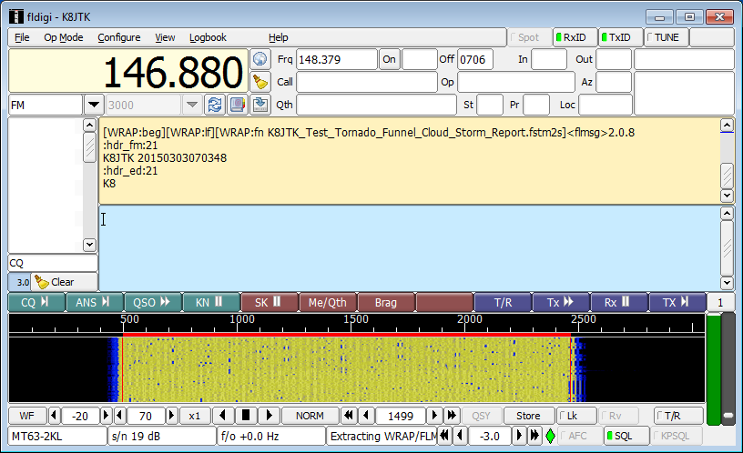
FLDigi
Free and supported on every platform
High and low speed modes
Supports ICS forms
Pre-written text
Keyboard to keyboard chat
MT-63 mode, slow but very reliable. Text only mode
8PSK mode can do file transfers of 50kb in 120 seconds

Slide 8
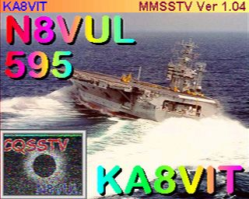
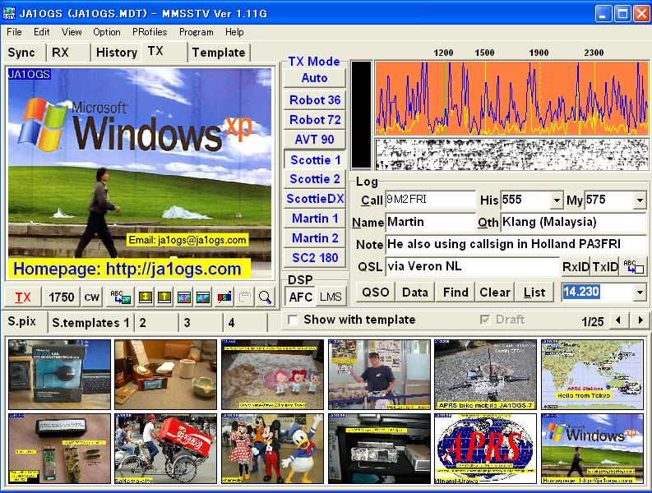
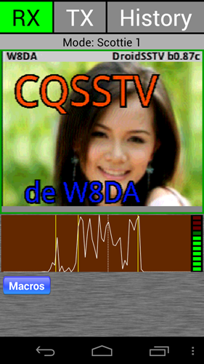

SSTV
Slow Scan Television
Used for sending images – like color faxes
Clarity is proportional to signal quality
Gets fuzzy as signal gets worse
Works with acoustic coupling
MMSSTV for windows
MultiScan/MultiMode for OSx
DroidSSTV and SSTV (black cat)

Slide 9
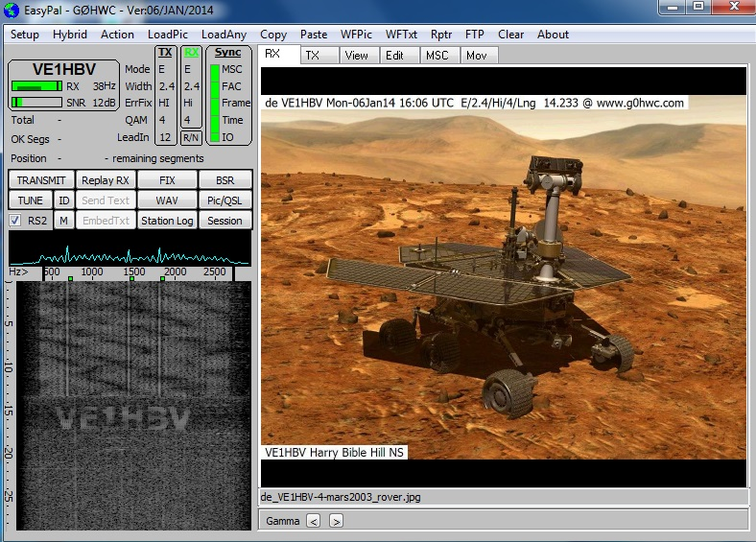
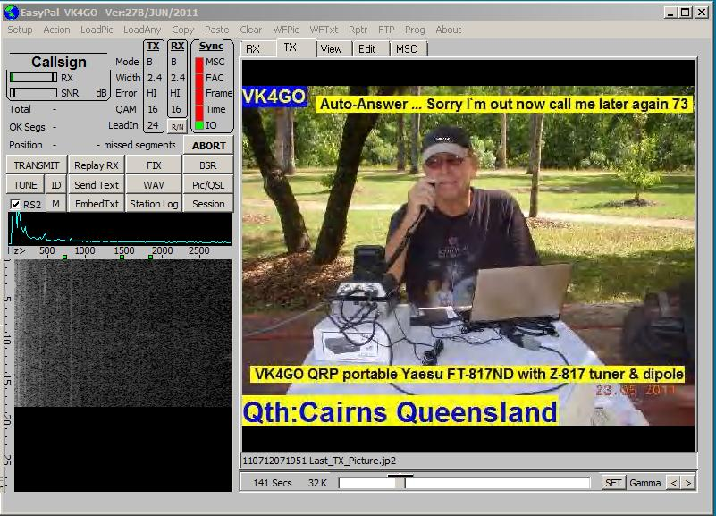
EasyPal
Digital (ADTV)
High Quality images
Won’t work with poor signal levels – fussy in the field
No more development
Neighboring counties have standardized on SSTV

Slide 10
How is McARES using Soundcard modes?
Images to the County and City EOC is first on the list
Equipment
  Two digital kits
    County funded
    Packet, soundcard modes
  Signalink installed at the EOC
Planning
  Several meetings with MCEM and county GIS
  EOC procedures
  Field procedures
Training and critical mass
  We are just starting out, survey has indicated interest
  Looking for a digital net manager (will train!)
  Looking for soundcard elmers
  Have a council crest 440 repeater available for practice
  Field Team training on the digital kits

