Slide 1
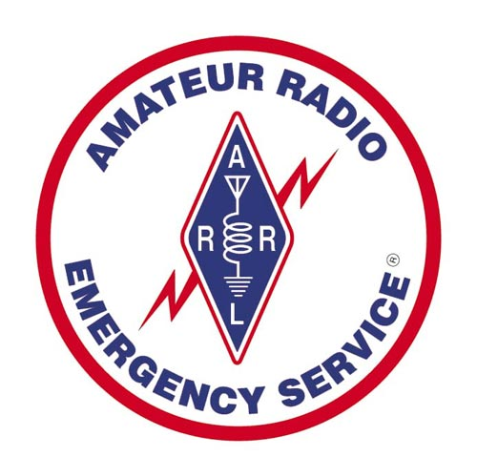
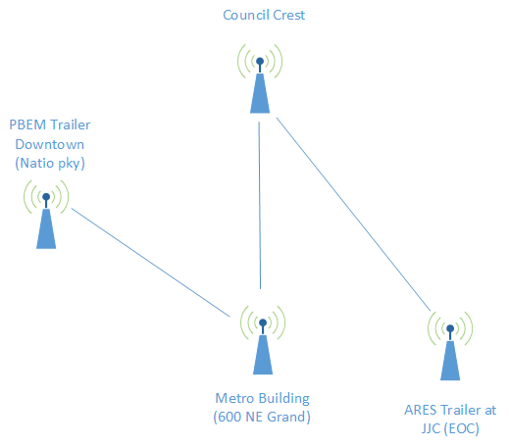
Multnomah County ARES
May 2016
MultnomahARES.org Leadership@multnomahARES.org

Slide 2
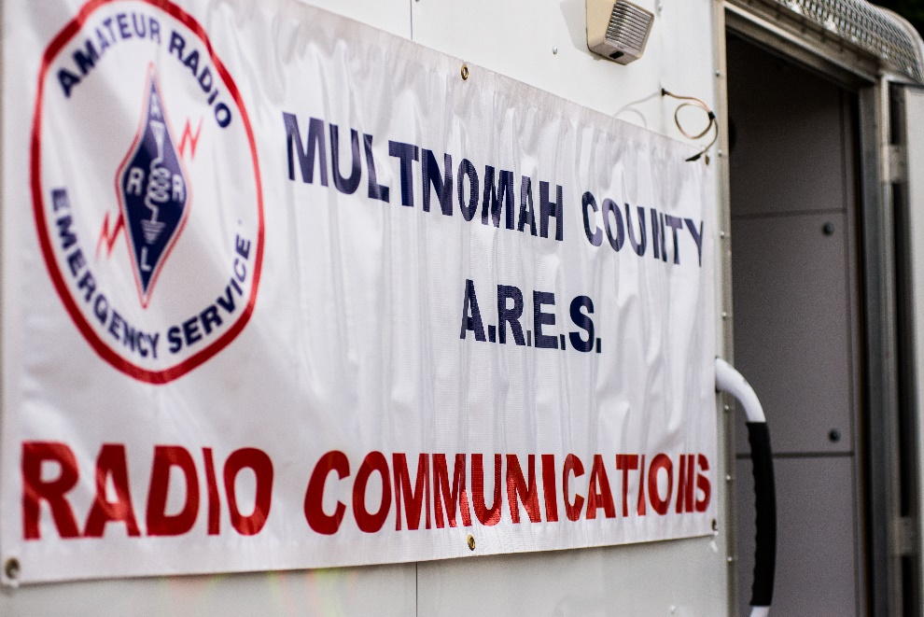
Welcome to the ARRL field unit for Multnomah County!
First Meeting? Please introduce yourself!
Please sign the attendance sheet.
Photo: Robert Anglin

Slide 3
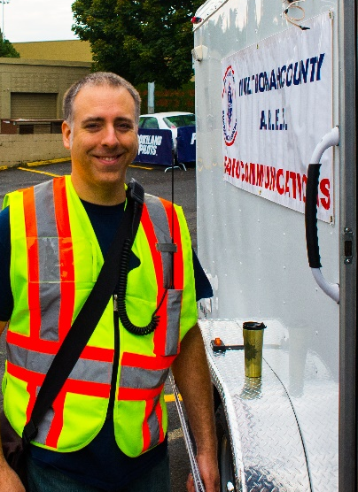
Leadership Team
Emergency Coordinator: Nathan Hersey N9VCU
Assistant EC: Adam Karol KF7LJH
Assistant EC: Robert Anglin WX5TEX
Assistant EC: Deb Provo KK7DEB
Training Manager: Steve Konrad AF7DD
Net Manager: Marino Duregon KG7EMV
Web Master: Brian Cochrane KE7QPV
PIO: Steve Hall W7RSH
Photo: Robert Anglin

Slide 4
Team Leaders
Multnomah County ECC: Deb Provo KK7DEB
Portland Bureau of Emergency Management: Brian Cochrane KE7QPV
City of Gresham and East County: Robert Anglin WX5TEX
Red Cross: John Beaston K7TY
Oregon Food Bank: Kiri Hargie K7KAH
Lewis and Clark College: Julie Couch W7OW
Rover: Michael Schilmoeller AE7XP
Field Net Control – Adam Karol KF7LJH
West Side Field Relay Team – Steve Hall W7SRH

Slide 5
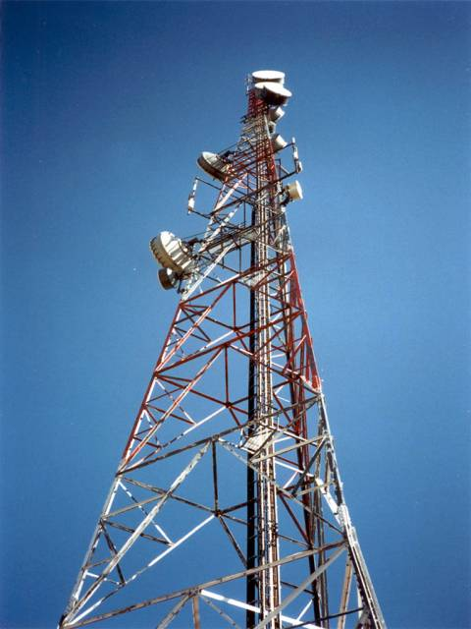
Agenda
Leadership Updates
Events Upcoming
Training

Slide 6
Regular Meetings and Nets
PARC: Fourth Friday of the Month, 7:30pm at Liberty Centre Building (W7LT.org)
HVARC: Third Thursday of the Month, 7:30pm MHCC Rm 1001 (WB7QIW.org) –
ARES net: Wednesdays 7:00pm on 146.840
  Sign Up and Do It!
NWTTN: Nightly at 6:05pm on WORC repeaters.
Neighborhood Emerg. Comms Training net (NECTN): 8:00pm on ARRG Linked system
  Now the largest net on the ARRG system – Go Michael!

Slide 7
Leadership updates
Contact Leadership
  Leadership@multnomahares.org
Cascadia Rising / BEECN exercise
Spring Set Wrap Up
Training Videos
Weekly Net Control
Digi Kits
Digital Webinar and certification events just completed

Slide 8
Leadership updates
New Digital Modes Training Net
  First Net Scheduled for Tuesday 7 June at 8 pm
  The first Tuesday of each month will be the dedicated time for our new training net – digital modes. This is hosted by Matthew Bradburn, and will explore image transfer (SSTV) and text transfer via FLDigi and the MT63-2000 mode. The net is structured as a voice net in which stations check in with net control, then take turns transmitting digitally. The primary goal is learning and practice (Time to jump in...if you’ve never transmitted data before!).
  The repeater is on 443.300 (100 Hz tone) located on Council Crest. Please limit transmissions to 120 seconds at a time to avoid heating issues.
  www.multnomahares.org/resources/nets/mcares-digital-net/

Slide 9
Leadership updates
State ARES Leadership Conference
  Thanks to all of the ARES/RACES operators throughout the state!
  Thanks to Multnomah County for completing Operating Certifications and training!
    New state online training format is coming, minimal impact to MC
  Operations Manual Update
  ARES MAT team(s)
  SET – 25Counties participated!
  Cascadia Rising – Pics!
  60M operations for solar minimums

Slide 10
Leadership updates
State ARES Leadership Conference
  OADN (and general Winlink) Operating Notes
    DO NOT REPLY ALL
    If emailing W7OEM on official business, use K7MCE
    ICS 213
      To
      From
      Position
      Signatures
    Transmit the msg as delivered cheerfully and as quickly as possible

Slide 11
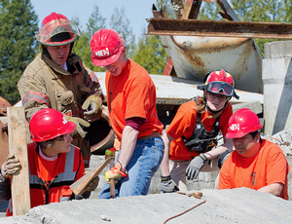
Cascadia Rising
June 7-10th
Day 1 – No Comms infrastructure
Mostly Operations between MCEM, PBEM and OEM
Staffing – OK, but if you’re dying to participate contact KK7DEB

Slide 12
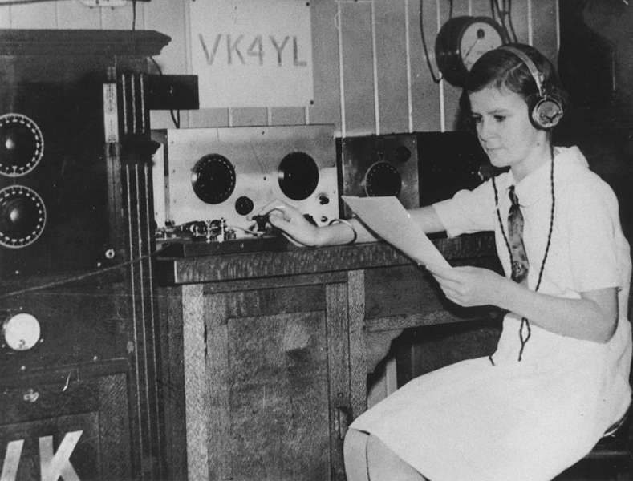
Events/Training Upcoming
SeaPac
  June-3,4,5
Cascadia Rising
  June 7th, 8th ,9th and 10th
Grand Floral Parade
  June 11th
  Contact Tony Carlson
    Tcarlson@lhs.org
Field Day
  June 25th and 26th
    HVARC or PARC

Slide 13

Any other announcements ?

Slide 14
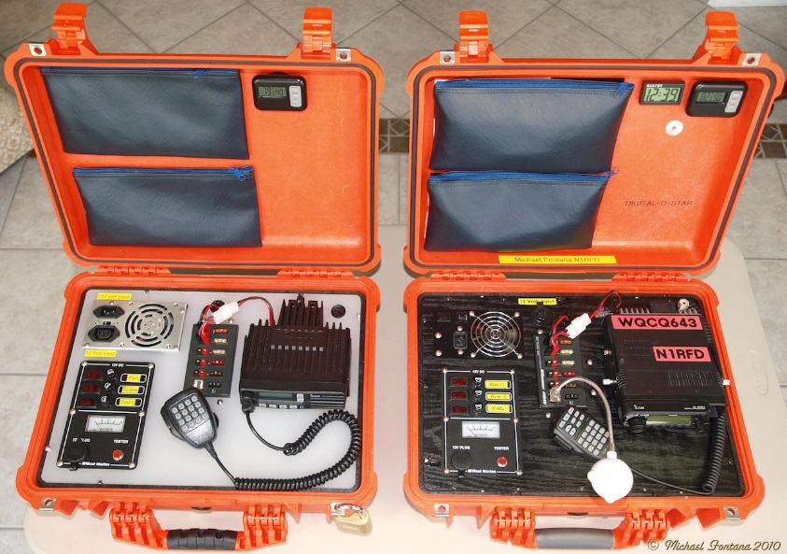
Portable operations in the field
Goals –
  All operators should strive to have the ability to effectively set up and operate a VHF voice field station, passing traffic (both written and tactical)
  Stretch Goal – VHF digital operations from the field
  God Among Men – VHF and HF Digital operations portable with sustained battery charging

Slide 15
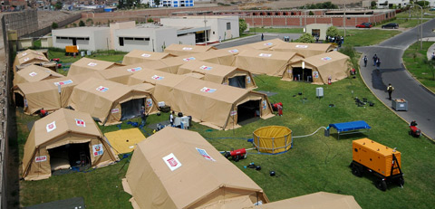
Portable operations in the field
Why Portable Field Ops?
  We have done a decent job of placing fixed equipment around the area
  The Director of MCEM wants to make sure he has the flexibility in communicating with field placed emergency support functions

Slide 16
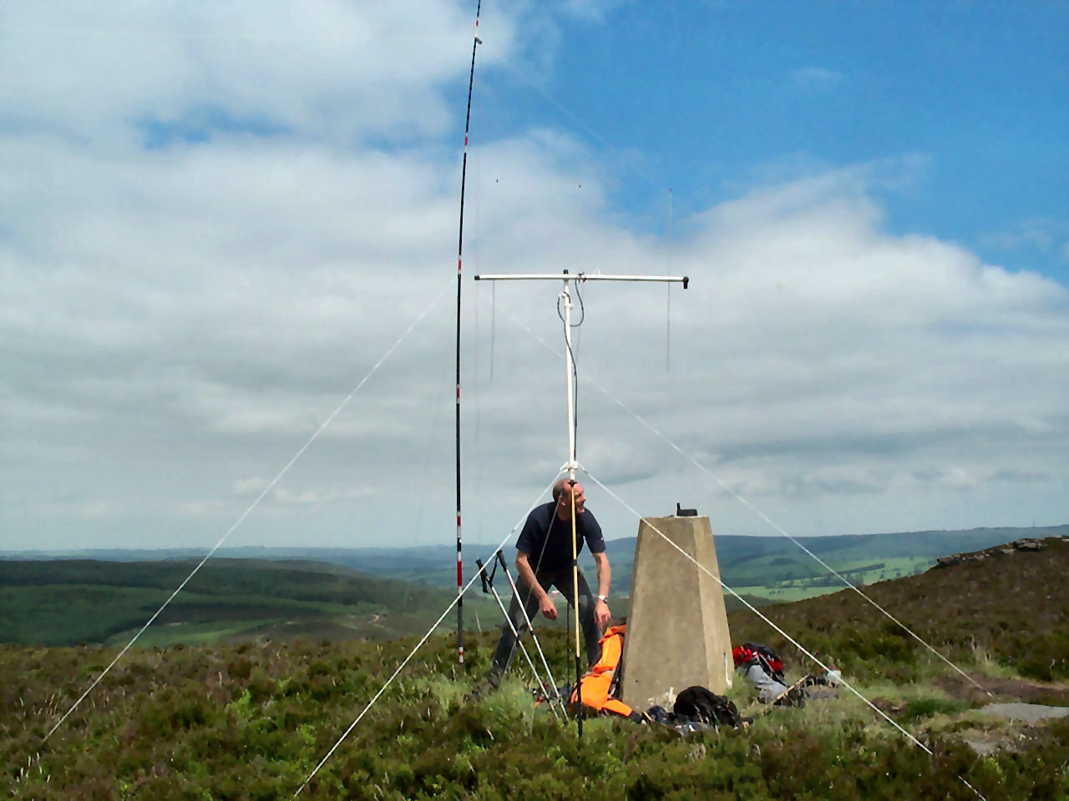
Station Considerations
Power
Antenna / Feedline
Radio
Digital interface
Computer
Operating ancillaries

Slide 17
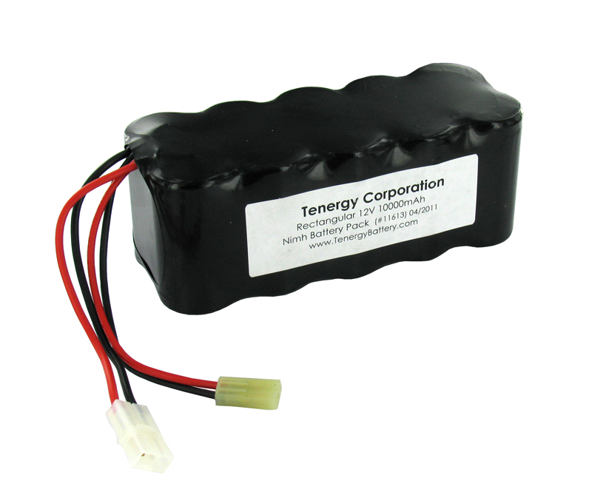
Battery Specs
How long does one need to operate unsupported by generators?
Duty Cycle?
Current Draw on Rx, Current Draw on Tx
3A * 4 Hrs = 12 Ah
Cost and Portability
  NIMh – Middle of the road expense and weight
  LiPo – Light, but special chargin considerations and not too cheap
  Sealed Lead Acid – Heavy!!!

Slide 18
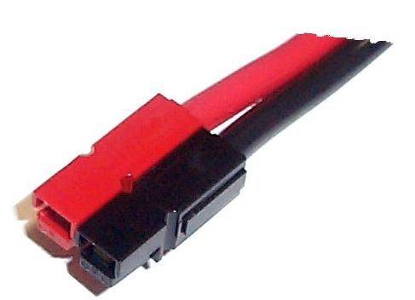
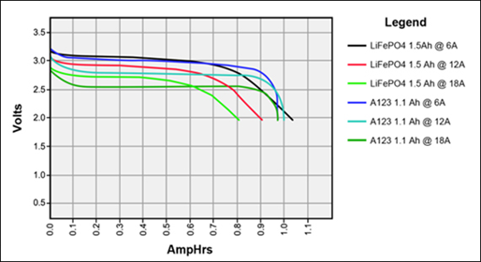
Battery Operation
Terminal Voltage
  Open Circuit vs under load!!
  Know your Battery!
Recharging
  Solar?
  Know your Battery!

Slide 19
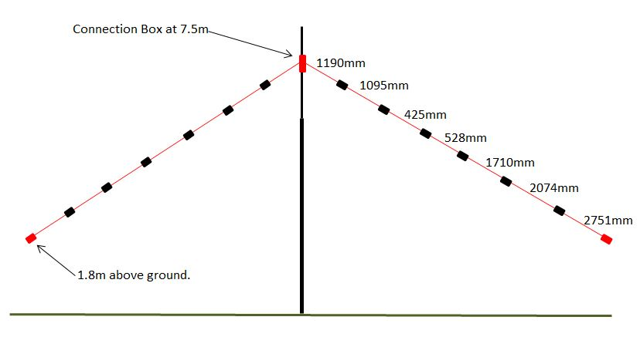
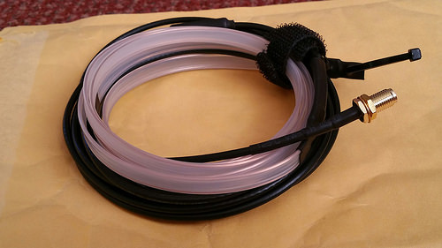
Antennas and Feedline
Your field antenna should be light and easy to setup, and hopefully minimally intrusive
  How to Erect?
  VHF – Roll up Jpole
  HF – Multi Band Dipole? Single Band Dipole? Vertical ?!? End-Fed?!?
  Transmatch

Slide 20
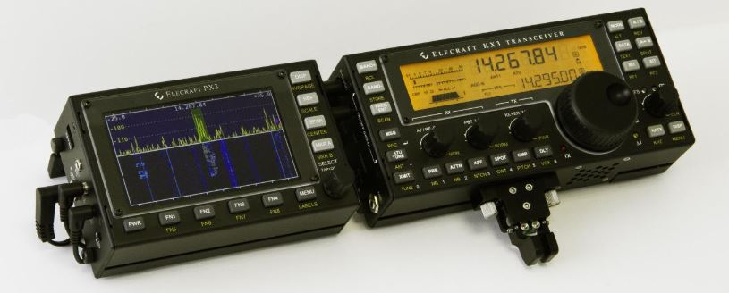
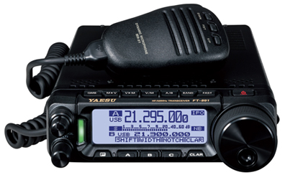
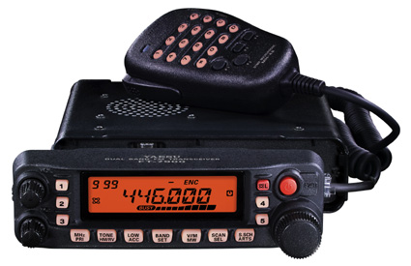
Radios
VHF vs DC to Daylight
Current draw on Receive
Power Output
Rx sensitivity
Linearity at low terminal voltage

Slide 21
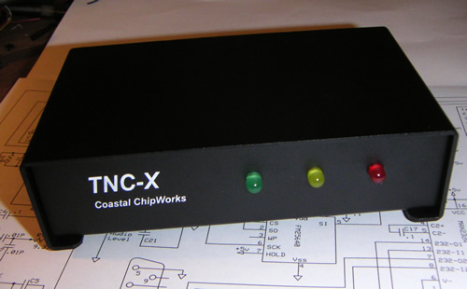
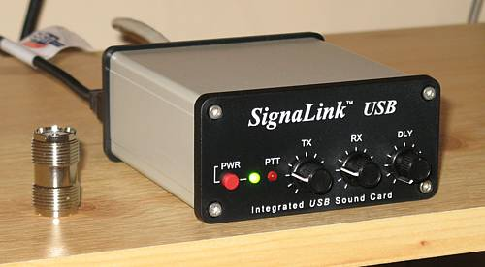
Digital interface
Computer – Laptop with decent battery Life
Soundcard Modem
TNC

Slide 22
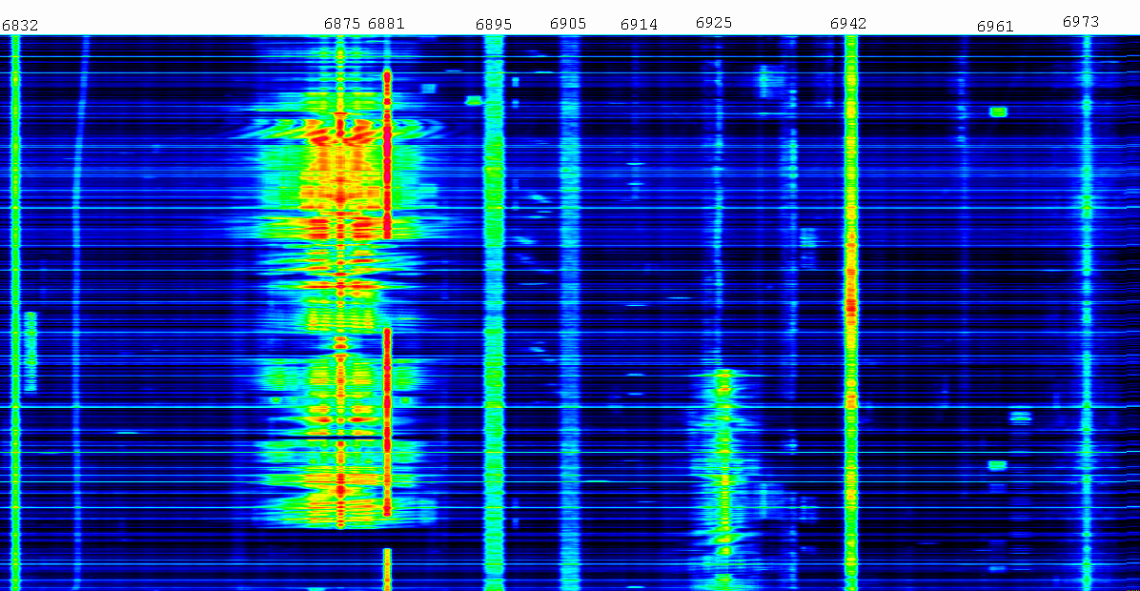
Software
RMS Express
FLDigi
EasyPal

Slide 23
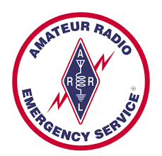

Questions?

