Slide 1

Multnomah County ARES
Introduction to HSMM and Mesh Networking
Brian Cochrane, KE7QPV KE7QPV@arrl.net

Slide 2
What is HSMM?
High Speed Multimedia – digital transmission of data/images/audio/video over Amateur Radio microwave frequencies
Data rates of 1Mbps to 130Mbps – hundreds to thousands of times faster than Packet Radio
WiFi equipment, operated under FCC Part 97 rules instead of Part 15

Slide 3
FCC Part 15 vs. Part 97
Part 15: Unlicensed, Consumer WiFi
Part 97: Amateur Radio, HSMM
Unlicensed; must not interfere with licensed users
900MHz, 2.4GHz, and 5.8GHz bands
Max TX power 1W; lower with antenna gain >6dBi
Licensed as primary or secondary user
900MHz, 2.4GHz, 3.4GHz, and 5.8GHz bands; some non-Part 15 frequencies
Max TX power 1.5kW; no antenna gain restrictions

Slide 4
What can we do with it?
Video
Voice
E-mail; instant messaging
File transfers; web services
Just about any other application that can run on a TCP/IP network

Slide 5
Examples of HSMM uses for Emcom
Backup Internet link for EOC
Data/voice link between shelters and operations/logistics
Remote video feeds for situational awareness

Slide 6
Distance
Dependent on many factors – TX power, RX sensitivity, antenna gain, noise, obstructions
Ubiquiti claims 30km+ for some devices
HamWAN Puget Sound Data Ring has several links in the 30~60 mile range

Slide 7
Technical Limitations
Clear line of sight required (900MHz can handle some foliage and other obstructions) - antennas need to be above buildings and trees
Microwave frequencies are attenuated by moisture - fog and heavy rain can affect link
High noise floor on 900MHz and 2.4GHz due to WiFi equipment, cordless phones, and other Part 15 devices

Slide 8
Network Topology
Point to Point (PtP) – single link between two radios
Point to Multipoint (PtMP) - links between two or more radios and one common radio; also called Star or Hub and Spoke topology
Mesh - each radio has multiple links to other radios
Hybrid – some combination of PtP, PtMP, and/or Mesh

Slide 9
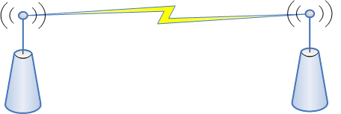
Point to Point (PtP) Network Topology

Slide 10

Point to Point (PtP) Network Topology
Most basic network topology
Think of it as a simplex QSO between two stations
Can simply link two laptops, a laptop and an IP camera, or even two complex networks
Uses high-gain Yagi or dish antennas

Slide 11
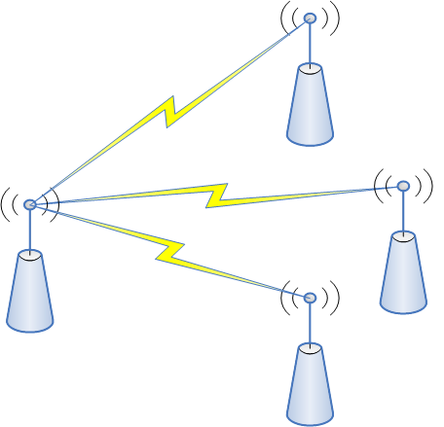
Point to Multi Point (PtMP) Network Topology

Slide 12

Point to Multi Point (PtMP) Network Topology
Think of it as a repeater – allows communication between stations unable to reach each other directly
Hub site is potential single point of failure – if it fails, the whole network goes down
Uses omnidirectional or sector antennas

Slide 13
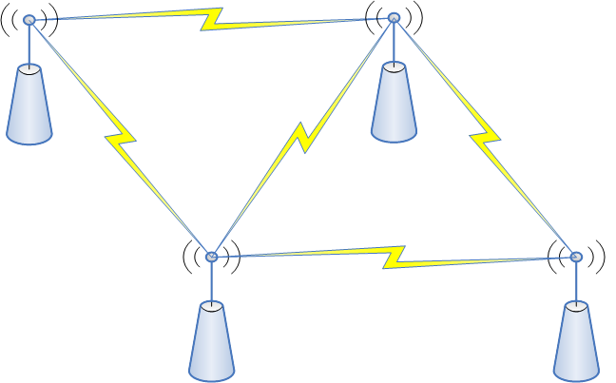
Mesh Network Topology

Slide 14

Mesh Network Topology
Very common HSMM topology
Think of it as a wide area simplex net – some stations can relay messages between others that can’t hear each other directly
Resilient – if one station fails, traffic can be routed through others

Slide 15
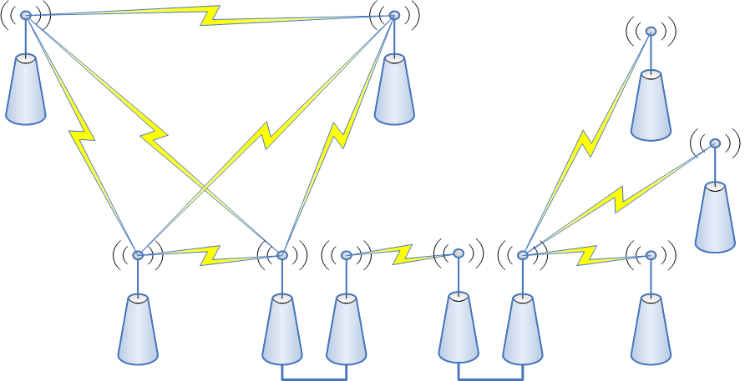
Hybrid Network Topology

Slide 16

Hybrid Network Topology
Large networks will likely be a mix of PtP, PtMP, and Mesh topologies
Separate local networks may be connected over wide area by PtP links, possibly on another band

Slide 17
HSMM Networking Projects
Broadband-Hamnet, formerly HSMM-MESH
  www.Broadband-Hamnet.org
AREDN (Amateur Radio Emergency Data Network)
  www.AREDN.org
HamWAN
  www.HamWAN.org

Slide 18
Broadband-Hamnet (BBHN)
Self-discovering, self-configuring mesh network
Replaces stock access point firmware
Supports Linksys and Ubiquiti hardware (see http://broadband-hamnet.org/which-hardware-to-use.htm for supported models)
Little or no networking knowledge required to set up a simple network

Slide 19
AREDN
Self-discovering, self-configuring mesh network
Replaces stock access point firmware
Supports Ubiquiti and TP-Link hardware (see www.aredn.org/content/supported-platform-matrix for supported models)
Offshoot of BBHN, more feature-rich
Supports 802.11n – higher data rates
Little or no networking knowledge required to set up a simple network

Slide 20
HamWAN
Planned, engineered network – not automatically discovered/configured like BBHN and AREDN
Standardized on Mikrotik hardware
Setup requires strong data networking and RF engineering skills
Potentially a faster network than BBHN, AREDN
Mix of PtP and PtMP topologies

Slide 21
BBHN and AREDN Hardware
Linksys
  WRT54G, WRT54GL (only some hardware versions)
Ubiquiti
  Most models in the airMAX M product line
TP-Link
  CPE210, CPE510

Slide 22
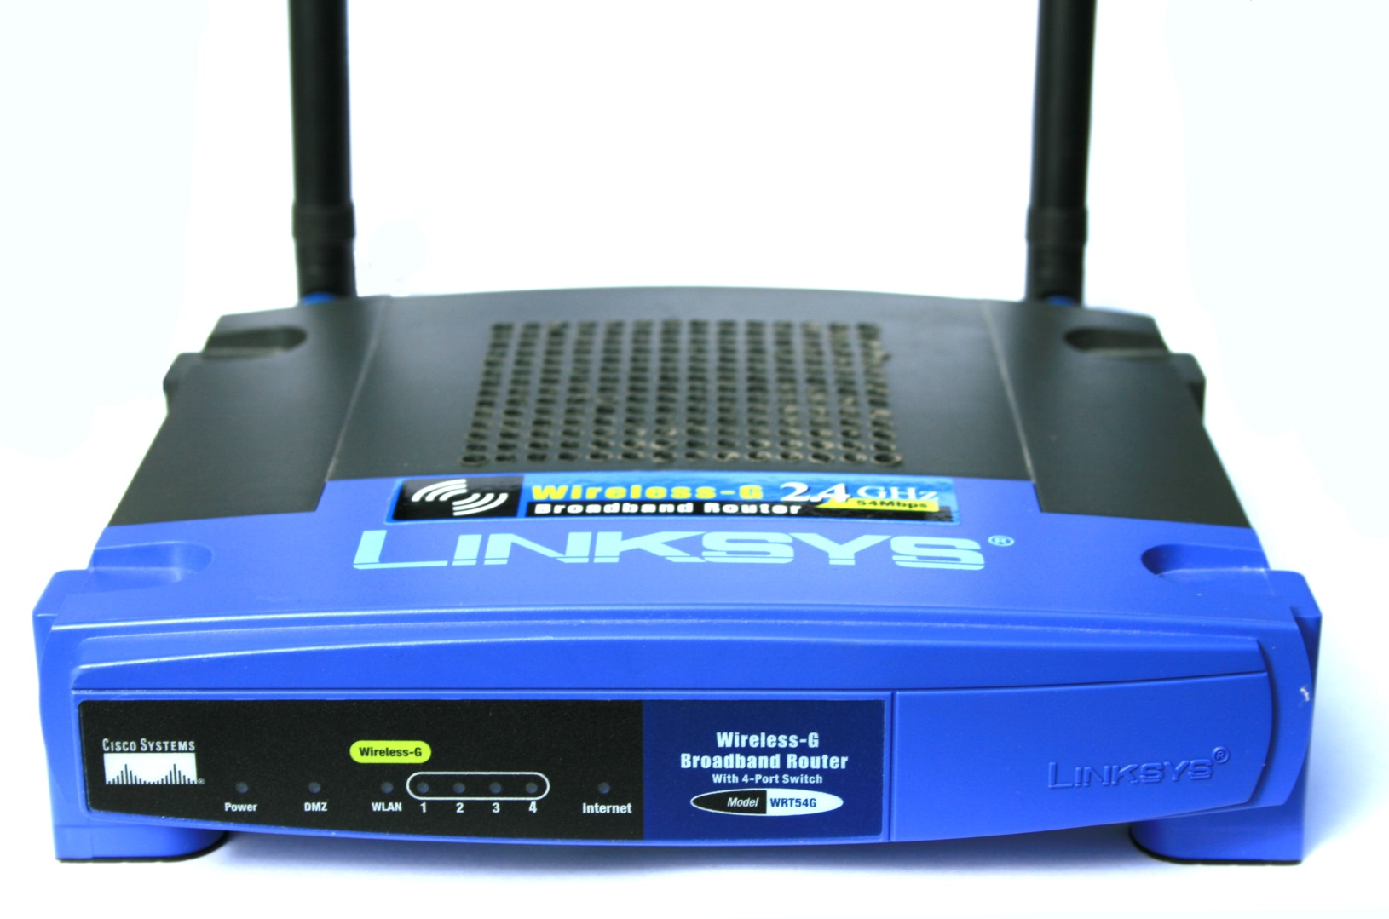
Linksys Hardware

Slide 23
Linksys Hardware
Pro
  Inexpensive
  Built-in 5-port switch
  Easy way to get your feet wet with Broadband-Hamnet
Con
  Low transmit power (<85mW)
  Low-gain (5dBi) stock omni antennas
  Only available for 2.4GHz band
  Not weatherproof
  Supported models no longer in production

Slide 24

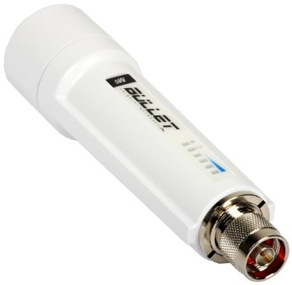
Ubiquiti Hardware

Slide 25
Ubiquiti Hardware
Pro
  Higher transmit power (up to 630mW on some models)
  Higher gain stock antennas (7.5dBi – 22.5dBi)
  Models available for 900MHz, 2.4GHz, 3.4GHz, and 5.8GHz bands
  All models fully weatherproof
  MIMO support – higher data rates
  Power over Ethernet (PoE) capability
Con
  No built-in switch
  More expensive for getting started

Slide 26
What is Multnomah County ARES doing with HSMM?
Evaluating suitability for rapidly field deployable data links, primarily for image transfer and video
Focusing on Ubiquiti radios and AREDN firmware
Currently in learning and experimentation phase

Slide 27
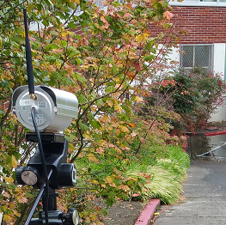
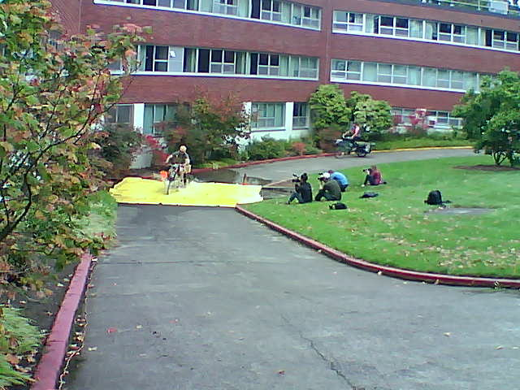
What have we done so far?
2015 DRT - live video feed from checkpoint
to comms trailer over a 1650’ 900MHz link

Slide 28
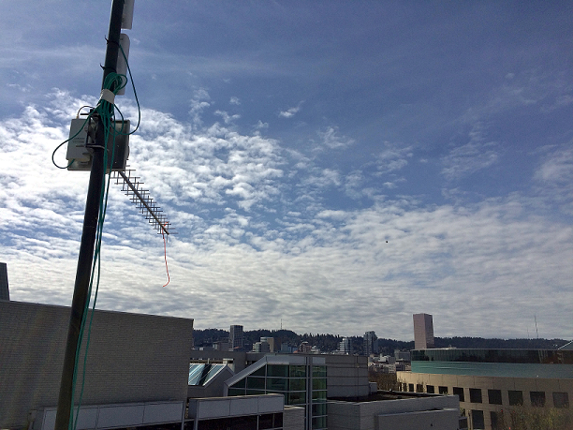
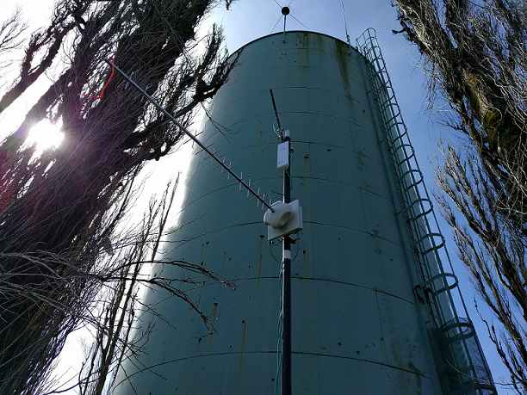
What have we done so far?
Field Test – 3 mile link on 900MHz, 2.4GHz,
and 5.8GHz from Council Crest to parking garage

Slide 29
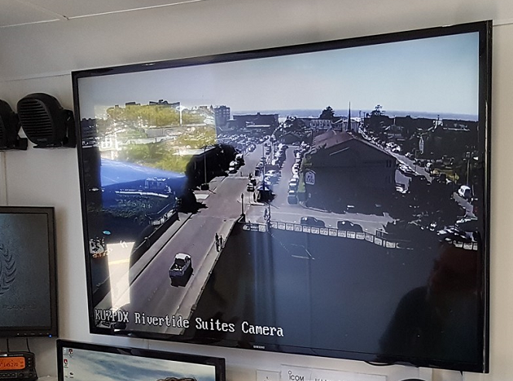
What have we done so far?
SeaPac 2016 – Video feed from camera on
roof of hotel across the river from MCARES trailer

Slide 30
Resources
Wireless Networking in the Developing World (not specific to HSMM but an excellent primer on wireless networking): http://WNDW.net/
AREDN: http://www.AREDN.org
Broadband-Hamnet: http://www.Broadband-Hamnet.org
HamWAN: http://www.HamWAN.org
Washington County ARES: http://WashCoARES.org/?page_id=1227
Santa Clara County ARES: http://www.SCC-ARES-RACES.org/mesh/

Slide 31
Demonstration

Slide 32


Questions?

