Slide 1


Multnomah County ARES
October 2016
MultnomahARES.org Leadership@multnomahARES.org

Slide 2

Welcome to the ARRL field unit for Multnomah County!
First Meeting? Please introduce yourself!
Please sign the attendance sheet.
Photo: Robert Anglin

Slide 3

Leadership Team
Emergency Coordinator: Nathan Hersey N9VCU
Assistant EC: Adam Karol KF7LJH
Assistant EC: Robert Anglin WX5TEX
Assistant EC: Deb Provo KK7DEB
Training Manager: Steve Konrad AF7DD
Net Manager: Marino Duregon KG7EMV
Web Master: Brian Cochrane KE7QPV
PIO: Steve Hall W7RSH
Photo: Robert Anglin

Slide 4

Team Leaders
A- Robert Anglin
B- Matthew Bradburn
C- Steve Hall
D- Nate Hersey
E- Eli Pride
M-Adam Karol

Slide 5
Regular Meetings and Nets
PARC: Fourth Friday of the Month, 7:30pm at Liberty Centre Building (W7LT.org)
HVARC: Third Thursday of the Month, 7:30pm MHCC Rm 1001 (WB7QIW.org)
Digital Modes Training Net - first Tuesday of each month 8PM, 443.300 (100 Hz tone)
ARES net: Wednesdays 7:00pm on 146.840
  Sign Up and Do It!
Neighborhood Emerg. Comms Training net (NECTN): 8:00pm on ARRG Linked system
  Now the largest net on the ARRG system – Go Michael!

Slide 6

Agenda
Team Recognition
Leadership Updates
Team Re-org
Events Completed
Events Upcoming
Training

Slide 7
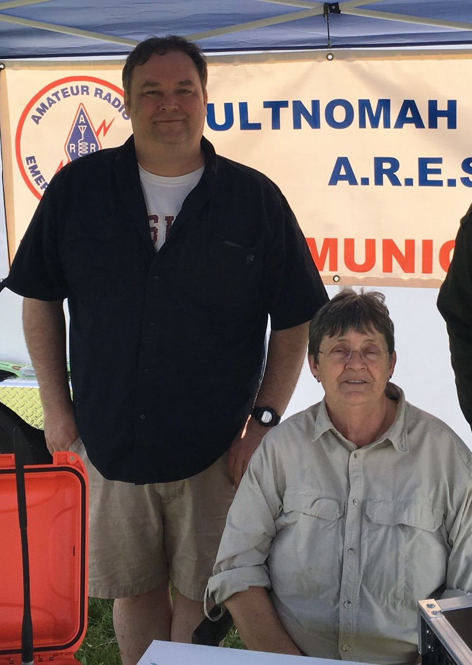
Way to go ARES!
And now a few words from Chris

Slide 8
Leadership updates
Contact Leadership
  Leadership@multnomahares.org
Several New County/Region Meetings
  Quarterly Comms, Radio Users, Interop
TICFOG
220 Repeater
NOVEMBER MEETING 1 WEEK EARLY!
DECEMBER – no gen mtg
Team Re-org

Slide 9
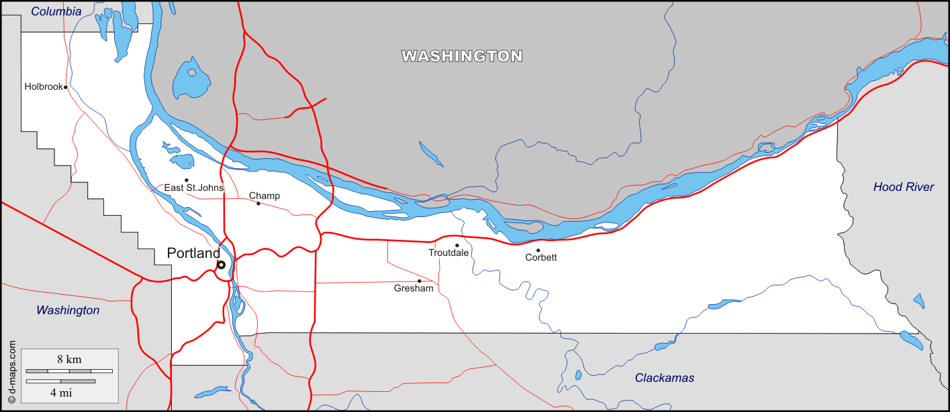
Team Re-org
Mission Alignment
Resource Balancing
Responsibility Sharing
Team Leaders
Station Chiefs
Operation Examples

Slide 10
Team Re-org
Alpha Team
Served agencies: Multnomah County ECC and Oregon Food Bank
Members living in northeast and some parts of southeast
Bravo Team
Served agency: Portland Bureau of Emergency Management (PBEM) ECC
Members living in southeast
Charlie Team
Served agency: Lewis and Clark College
Members living in southwest
Delta Team
Served Agency: Oregon Red Cross
Members living in north and northwest
Echo Team
Served Agencies: Cities of Gresham, Fairview, Troutdale, Wood Village and unincorporated east Multnomah County i.e. Corbett
Members living in East County
Mike Team
ARES mobile Communications unit
Mobile net control functions

Slide 11
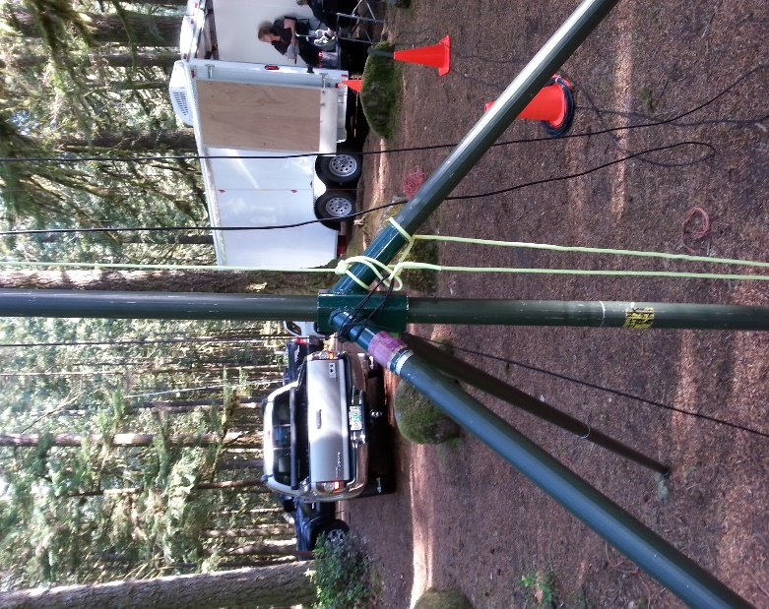
Events Completed
Sept 23rd-25 MCARES HF Campout
  Ft Stevens, NPOTA
BEECN – Sept 24th
OCT 1st – PARC work Party at Larch Mtn
  Antenna Replacement
Oct 9th Pdx Marathon
Oct15 SwaptoberFest
OCT 22nd – DRT

Slide 12

Events/Training Upcoming
Nov 5th Fall SET “Double Double”
  -First Phase –
    Notification
      EC expects phone call from DEC at some point in the day
      EC will inform AECs and needed Station Chiefs via phone, Text Messages to rest of membership notifying them of the active resource net
    Resource net
      MC2, as needed
  -Second Phase-
    Stations Activated as needed
      We will activate the JJC to send SitRep
      Most personnel won’t deploy

Slide 13


Other Announcements?

