Slide 1


Multnomah County ARES
Jan 2017
MultnomahARES.org Leadership@multnomahARES.org

Slide 2

Welcome to the ARRL field unit for Multnomah County!
First Meeting? Please introduce yourself!
Please sign the attendance sheet.
Photo: Robert Anglin

Slide 3

Leadership Team
Emergency Coordinator: Nathan Hersey N9VCU
Assistant EC: Adam Karol KF7LJH
Assistant EC: Robert Anglin WX5TEX
Assistant EC: Deb Provo KK7DEB
Training Manager: Eli Pride W7ELI
Net Manager: Marino Duregon KG7EMV
Web Master: Brian Cochrane KE7QPV
PIO: Steve Hall W7RSH
Photo: Robert Anglin

Slide 4

Team Leaders
A- Robert Anglin
B- Matthew Bradburn
C- Steve Hall
D- Nate Hersey
E- Eli Pride
M-Adam Karol

Slide 5
Regular Meetings and Nets
Clubs are where you can get ham stuff we don’t teach or drill!!!!
  PARC: Fourth Friday of the Month, 7:30pm at Liberty Centre Building (W7LT.org)
  HVARC: Third Thursday of the Month, 7:30pm MHCC Rm 1001 (WB7QIW.org)
Digital Modes Training Net - first Tuesday of each month 8PM, 443.300 (100 Hz tone)
THTN: 2nd and 4th Tues, 8:00 P.M. 147.180 (PL tone103.5)
ARES net: Wednesdays 7:00pm on 146.840
Neighborhood Emerg. Comms Training net (NECTN): Sundays 8:00pm on ARRG Linked system

Slide 6

Agenda
Leadership Updates
Team-Led Drills Structure
Events Completed
Events Upcoming
Forms Training

Slide 7
Leadership updates
Contact Leadership
  Leadership@multnomahares.org
  New Folks Q&A @ 6:15 prior to the meeting
Recruitment last year – 35 New Members!
Trailer is Operational!
MMSSTV capability expanding – Digi Kits!
Team Reorg!
Two new Nets!

Slide 8
Leadership updates
Contact Leadership
  Leadership@multnomahares.org
MMSSTV Coordinates - Standardization
Active Membership Status and Recruitment
New Team-Led Drills
Training Calendar
Training Manager
SOPs are updated
OR Section SET – April 22
Personal and Family Readiness Reminder
Net Control Duty – Teams assigned

Slide 9
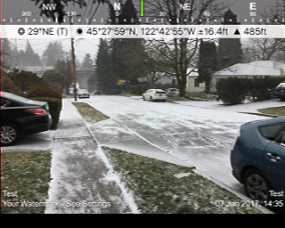
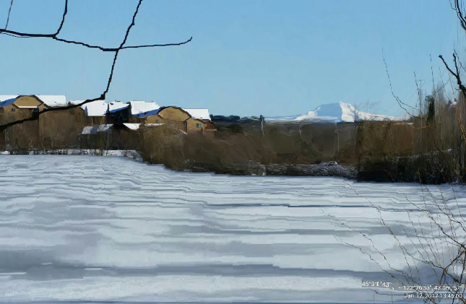
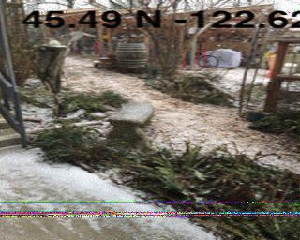
Events Completed
On the Fly imaging to PBEM
  Thanks to Adam for heading to PBEM to receive images as a test during snowpocolypse
Lessons Learned:
  Imagery Standardization (coordinates) needed
  WebEOC
  MCEM Digital Kits

Slide 10
Events/Training Upcoming
BEECN Drill Saturday Jan 28th
  ^{Bravo Team from PBEM}
Rickreall Sat Feb 18th
  Hamfest at Polk County Fairgrounds
Team-Led Drill Sat Feb 11th
  Charlie and Alpha Teams
Team Led Drill Sat Mar 11th
  Echo and Bravo Team
Roll up J Pole Workshop Sat Mar 25th
Spring SET Sat April 22nd

Slide 11
Team-Led Drill Concept
Seeking to increase exercise time and training value
Build the teams up so that each team can be self led and all teams can function together
  Scenarios determined by team leader
  Held the Second Sat of the Month 10am to 1200
    but not every month, see the training calendar for team’s schedule

Slide 12
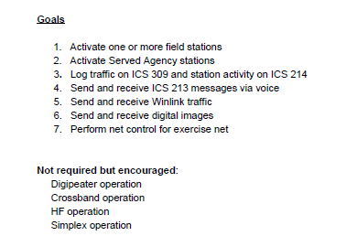
Team-Led Drill Concept

Slide 13
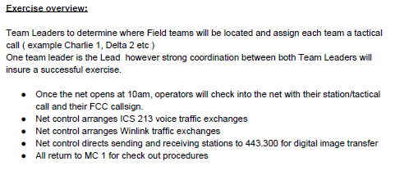
Team-Led Drill Concept

Slide 14
Team-Led Drill Concept
Note Frequency Limitations in Drill Guide
  We are sticking to freqs we have blanket permission to use
Team Leaders and Teams create the traffic needed for the drill
Drills will have 2 teams involved
DO YOUR AARs!!! - One page and standardized
  Turn in your logs

Slide 15
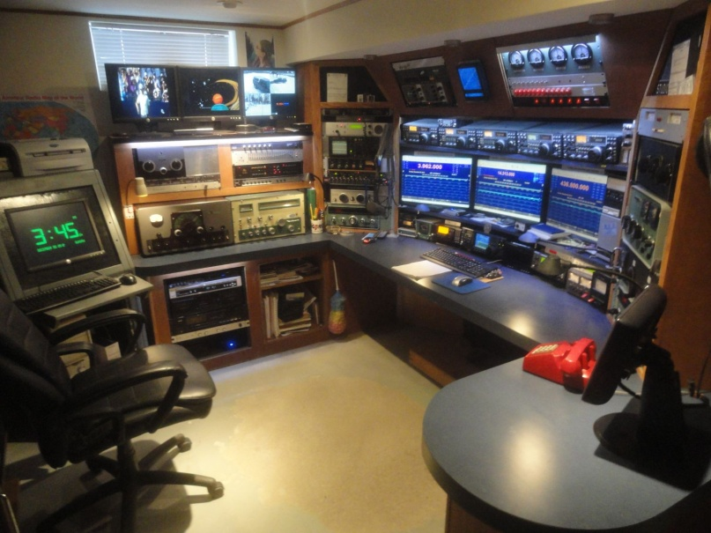
Forms and Logging
Forms?
  In an incident these are legal docs, will be collected and maintained, may be used to piece an incident together or to get the county paid!!!
  Biggies for a regular operator?
  ICS 213 Msg Form
  ICS 214 Unit Log
  ICS 309 Comms Log
  Also when in the field: NTS Traffic and the Life Safety Info Form

Slide 16
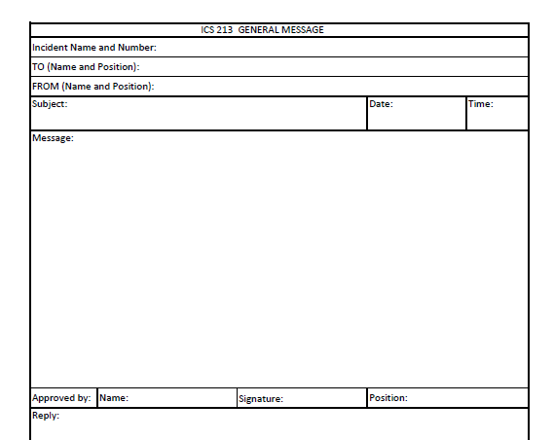
ICS 213 Msg Form

Slide 17
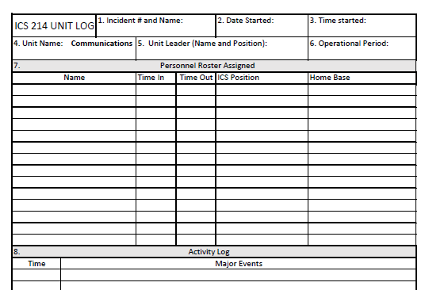
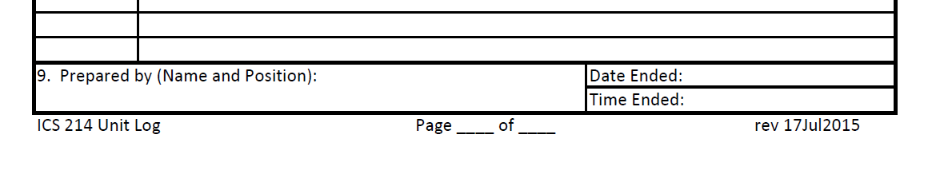
ICS 214 Unit Log

Slide 18
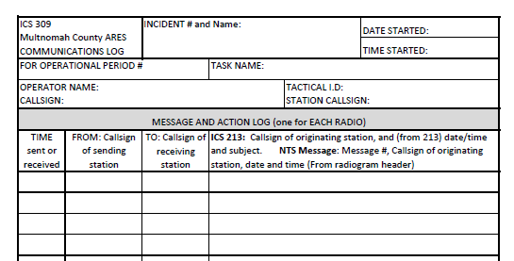
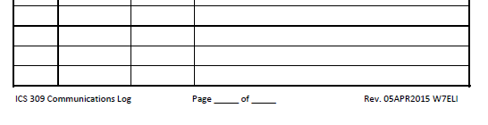
ICS 309 Comms Log

Slide 19


Other Announcements?

