Slide 1

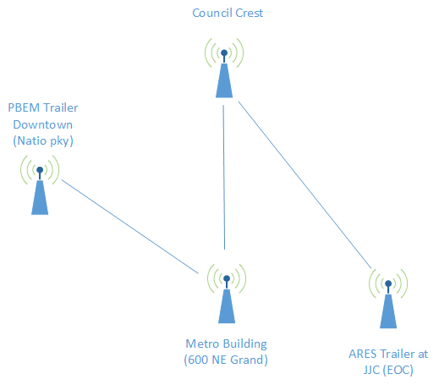
Multnomah County ARES
Mar 2017
MultnomahARES.org Leadership@multnomahARES.org

Slide 2
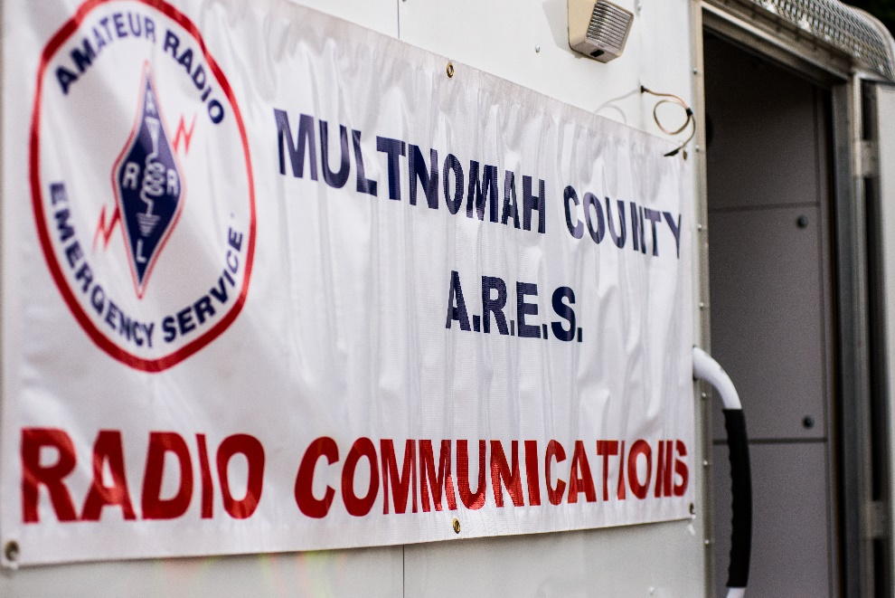
Welcome to the ARRL field unit for Multnomah County!
First Meeting? Please introduce yourself!
Please sign the attendance sheet.
Photo: Robert Anglin

Slide 3
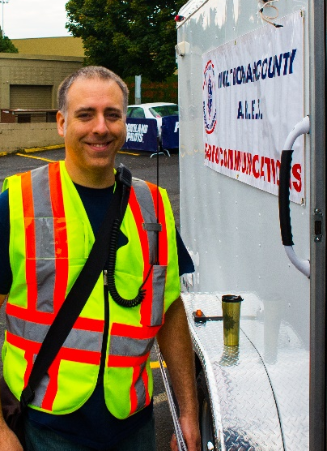
Leadership Team
Emergency Coordinator: Nathan Hersey N9VCU
Assistant EC: Adam Karol KF7LJH
Assistant EC: Robert Anglin WX5TEX
Assistant EC: Deb Provo KK7DEB
Training Manager: Eli Pride W7ELI
Net Manager: Marino Duregon KG7EMV
Web Master: Brian Cochrane KE7QPV
PIO: Steve Hall W7RSH
Photo: Robert Anglin

Slide 4
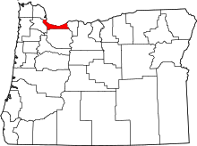
Team Leaders
A- Robert Anglin
B- Matthew Bradburn
C- Steve Hall
D- Nate Hersey
E- Eli Pride
M-Adam Karol

Slide 5
Regular Meetings and Nets
Clubs are where you can get ham stuff we don’t teach or drill!!!!
  PARC: Fourth Friday of the Month, 7:30pm at Liberty Centre Building (W7LT.org)
  HVARC: Third Thursday of the Month, 7:30pm MHCC Rm 1001 (WB7QIW.org)
Digital Modes Training Net - first Tuesday of each month 8PM, 443.300 (100 Hz tone)
THTN: 2nd and 4th Tues, 8:00 P.M. 147.180 (PL tone103.5)
ARES net: Wednesdays 7:00pm on 146.840
Neighborhood Emerg. Comms Training net (NECTN): Sundays 8:00pm on ARRG Linked system

Slide 6
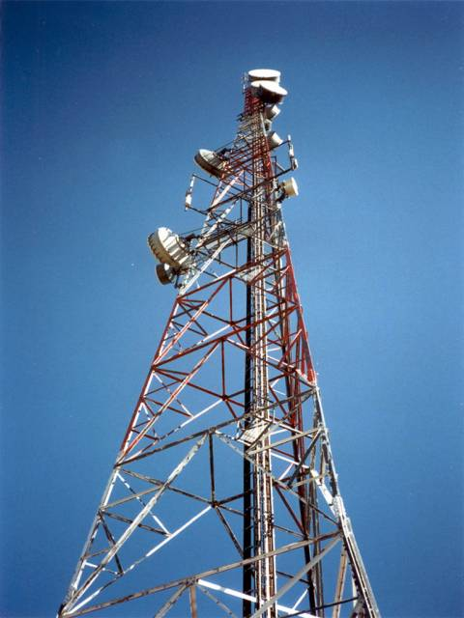
Agenda
Leadership Updates
Events Completed
Events Upcoming
Training

Slide 7
Leadership updates
Contact Leadership
  Leadership@multnomahares.org
  New Folks Q&A @ 6:15 prior to the meeting
Planning for Spring SET Continues
District Meeting
60M HF Net (FEMA Interop)
  Thanks Joe and Chuck and Julie and Steve!
State ARRL reporting Reqs
Trailer Licensing
Need Technical Support?

Slide 8
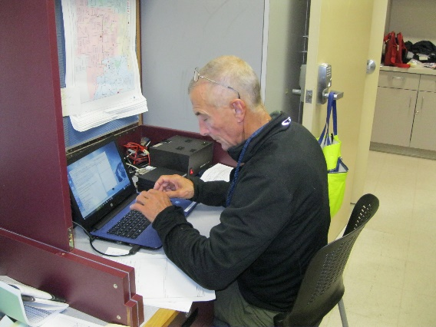
Events Completed
E/B Team Drill
Lessons Learned:
  First Drill for multiple folks– Thanks Matt!
    Voice Traffic
    ICS 309 Comms Log
    Accuracy is key – so Spell and Provide Fills as necessary!
  Practice Field Station Setup – ok
  Made contacts for potential operating location site access
  Field Kits are working well for MMSSTV
  Drill Length

Slide 9
Events/Training Upcoming
Antenna Build Workshop – Sat March 25th
WALK MS – Sat April 15th
  Ton of folks signed up
  Drone ops (ABJ)
Spring SET - Sat April 22nd
  Locations being arranged – Contact your team leader

Slide 10


Other Announcements?

