Slide 1


Multnomah County ARES
May 2017
MultnomahARES.org Leadership@multnomahARES.org

Slide 2

Welcome to the ARRL field unit for Multnomah County!
First Meeting? Please introduce yourself!
Please sign the attendance sheet.
Photo: Robert Anglin

Slide 3

Leadership Team
Emergency Coordinator: Nathan Hersey N9VCU
Assistant EC: Adam Karol KF7LJH
Assistant EC: Robert Anglin WX5TEX
Assistant EC: Deb Provo KK7DEB
Training Manager: Eli Pride W7ELI
Net Manager: Marino Duregon KG7EMV
Web Master: Brian Cochrane KE7QPV
PIO: Steve Hall W7RSH
Photo: Robert Anglin

Slide 4

Team Leaders
A- Robert Anglin
B- Matthew Bradburn
C- Steve Hall
D- Nate Hersey
E- Eli Pride
M-Adam Karol

Slide 5
Regular Meetings and Nets
Clubs are where you can get ham stuff we don’t teach or drill!!!!
  PARC: Fourth Friday of the Month, 7:30pm at Liberty Centre Building (W7LT.org)
  HARC: Third Thursday of the Month, 7:30pm MHCC Rm 1001 (WB7QIW.org)
Digital Modes Training Net - first Tuesday of each month 8PM, 443.300 (100 Hz tone)
THTN: 2nd and 4th Tues, 8:00 P.M. 147.180 (PL tone103.5)
ARES net: Wednesdays 7:00pm on 146.840
Neighborhood Emerg. Comms Training net (NECTN): Sundays 8:05pm on ARRG Linked system

Slide 6

Agenda
Leadership Updates
Events Completed
Events Upcoming
Training

Slide 7
Leadership updates
Contact Leadership
  Leadership@multnomahares.org
  New Folks Q&A @ 6:15 prior to the meeting
State ARRL reporting Reqs – Numbers for the Section ARRL Reports looking better
Spring SET AAR work continues
  Multnomah – Pre Briefs for new and major events
  VHF Radios in trailer repaired!
ARRL SM – Legislature committee testimony
  Well Received
  Shout Out to MC ARES!
Sisters ARES Section Meeting
  Thanks Deb!

Slide 8
Sisters State ARES mtg
38 Folks from around the state
Oregon Section – ARRL award for excellence in Cascadia Rising Drill
MC ARES recognition for OEMAA Award
ARRL – ARES program Upgrades
Section ARES executive committee

Slide 9
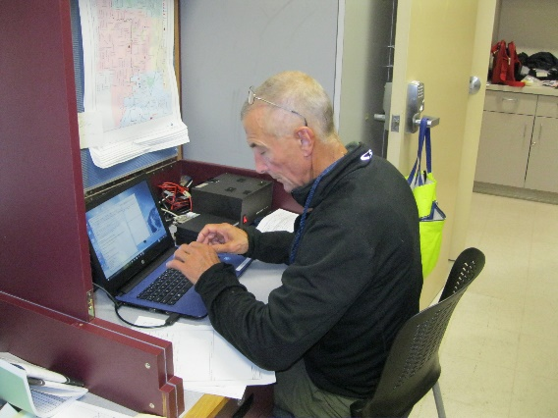
Events Completed
D/C Team Drill
  Logging
    309 Which tactical messages logged?
    214 logging was good
  Simplex/Simplex/Repeater Coverage – Hills are tough
  Digi Kits – Great to set up!
Going Forward – Attempt to incorporate PtP Winlink!

Slide 10
Events/Training Upcoming
SEA-PAC
  June 2/3/4
  Trailer Outreach
A/B Team Drill
  June 10th, Remember PtP!
Field Day –
PARC at Kelly Butte and HARC at Larch Mountain
  June 24th/25th
HF Campout - Molalla
  July 28th – 30th
  5bux/Person/Day

Slide 11


Other Announcements?

