Slide 1

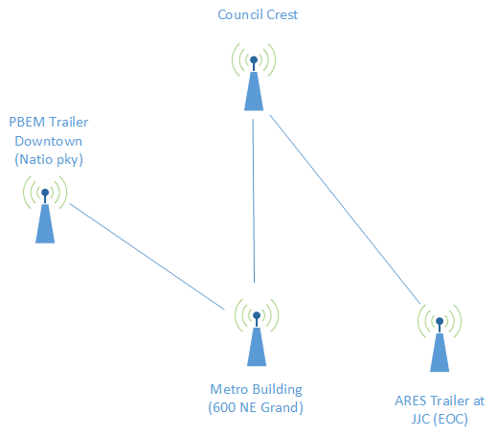
Multnomah County ARES
June 2017
MultnomahARES.org Leadership@multnomahARES.org

Slide 2
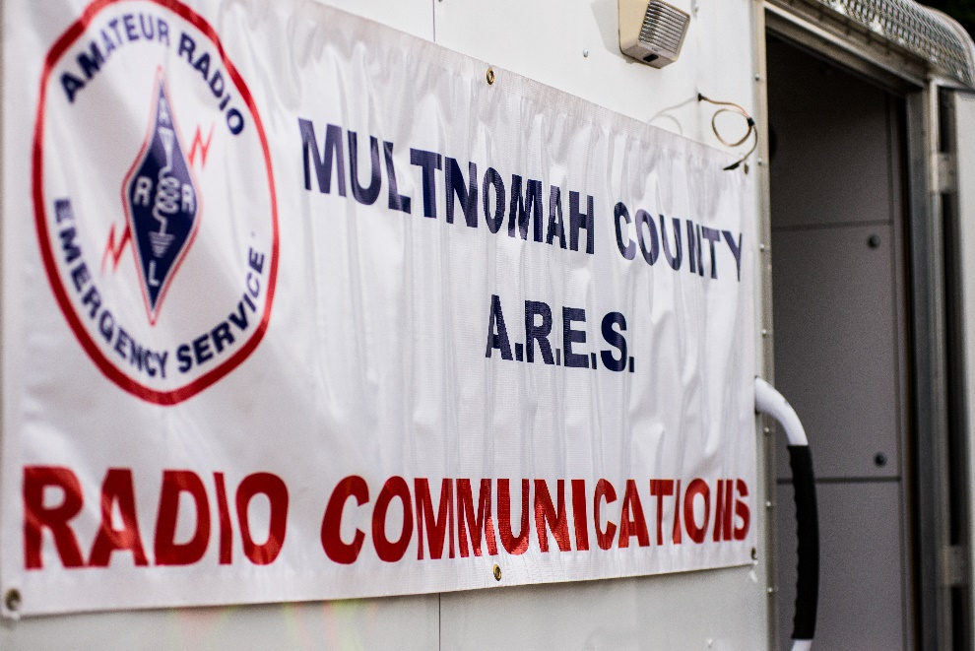
Welcome to the ARRL field unit for Multnomah County!
First Meeting? Please introduce yourself!
Please sign the attendance sheet.
Photo: Robert Anglin

Slide 3
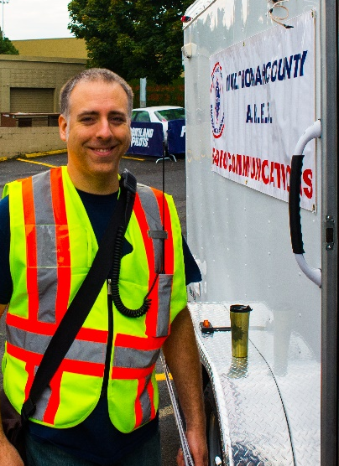
Leadership Team
Emergency Coordinator: Nathan Hersey N9VCU
Assistant EC: Adam Karol KF7LJH
Assistant EC: Robert Anglin WX5TEX
Assistant EC: Deb Provo KK7DEB
Training Manager: Eli Pride W7ELI
Net Manager: Marino Duregon KG7EMV
Web Master: Brian Cochrane KE7QPV
PIO: Steve Hall W7RSH
Photo: Robert Anglin

Slide 4
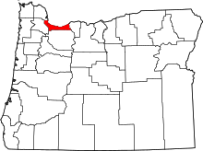
Team Leaders
A- Robert Anglin
B- Matthew Bradburn
C- Steve Hall
D- Nate Hersey
E- Eli Pride
M-Adam Karol

Slide 5
Regular Meetings and Nets
Clubs are where you can get ham stuff we don’t teach or drill!!!!
  PARC: Fourth Friday of the Month, 7:30pm at Liberty Centre Building (W7LT.org)
  HARC: Third Thursday of the Month, 7:30pm MHCC Rm 1001 (WB7QIW.org)
Digital Modes Training Net - first Tuesday of each month 8PM, 443.300 (100 Hz tone)
THTN: 2nd and 4th Tues, 8:00 P.M. 147.180 (PL tone103.5)
ARES net: Wednesdays 7:00pm on 146.840
Neighborhood Emerg. Comms Training net (NECTN): Sundays 8:00pm on 443.3 (+, 100Hz)

Slide 6
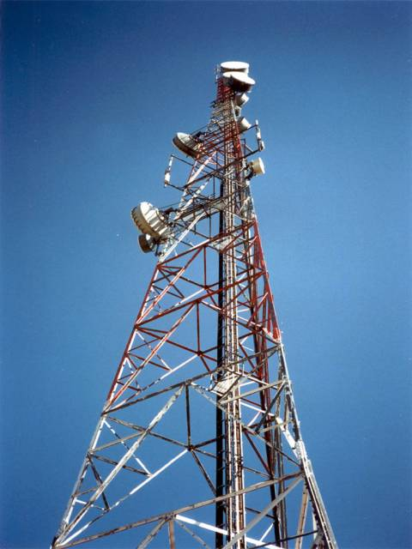
Agenda
Leadership Updates
Events Completed
Events Upcoming
Training

Slide 7
Leadership updates
Contact Leadership
  Leadership@multnomahares.org
  New Folks Q&A @ 6:15 prior to the meeting
National Reporting:
  48/71 sections reporting (OR included)
  1.1 Megabux of volunteer value (>58k personnel hours total amongst >22.8K ARES members)
DRT - Potentially in mid October
New training plan is live on web
OOEM Activation
Potential for Eclipse Ops – More infor being requsted

Slide 8
Leadership updates
Contact Leadership
  Leadership@multnomahares.org
DRT - Potentially in mid October
New training plan is live on web
OOEM Activation – Snap and handled
Potential for Eclipse Ops – More info to come
County Kits – In Progress
Team Hour Reporting
  Team Participation spreadsheet in ARES folder
PBEM EOC training

Slide 9
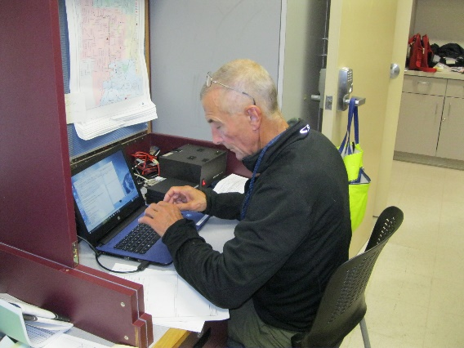
Events Completed
SEA-PAC outreach with Trailer
A/B Team Drill

Slide 10
Events/Training Upcoming
PARC at Kelly Butte and HARC at Larch Mountain
  June 24th/25th
July Meeting – Potluck in the parking lot + Raffle
HF Campout - Molalla
  July 28th – 30th
  5bux/Person/Day
Maker Faire – 9/17
Gresham Get Ready – 9/17
Hillsboro Air Show – 9/22 – 9/24

Slide 11
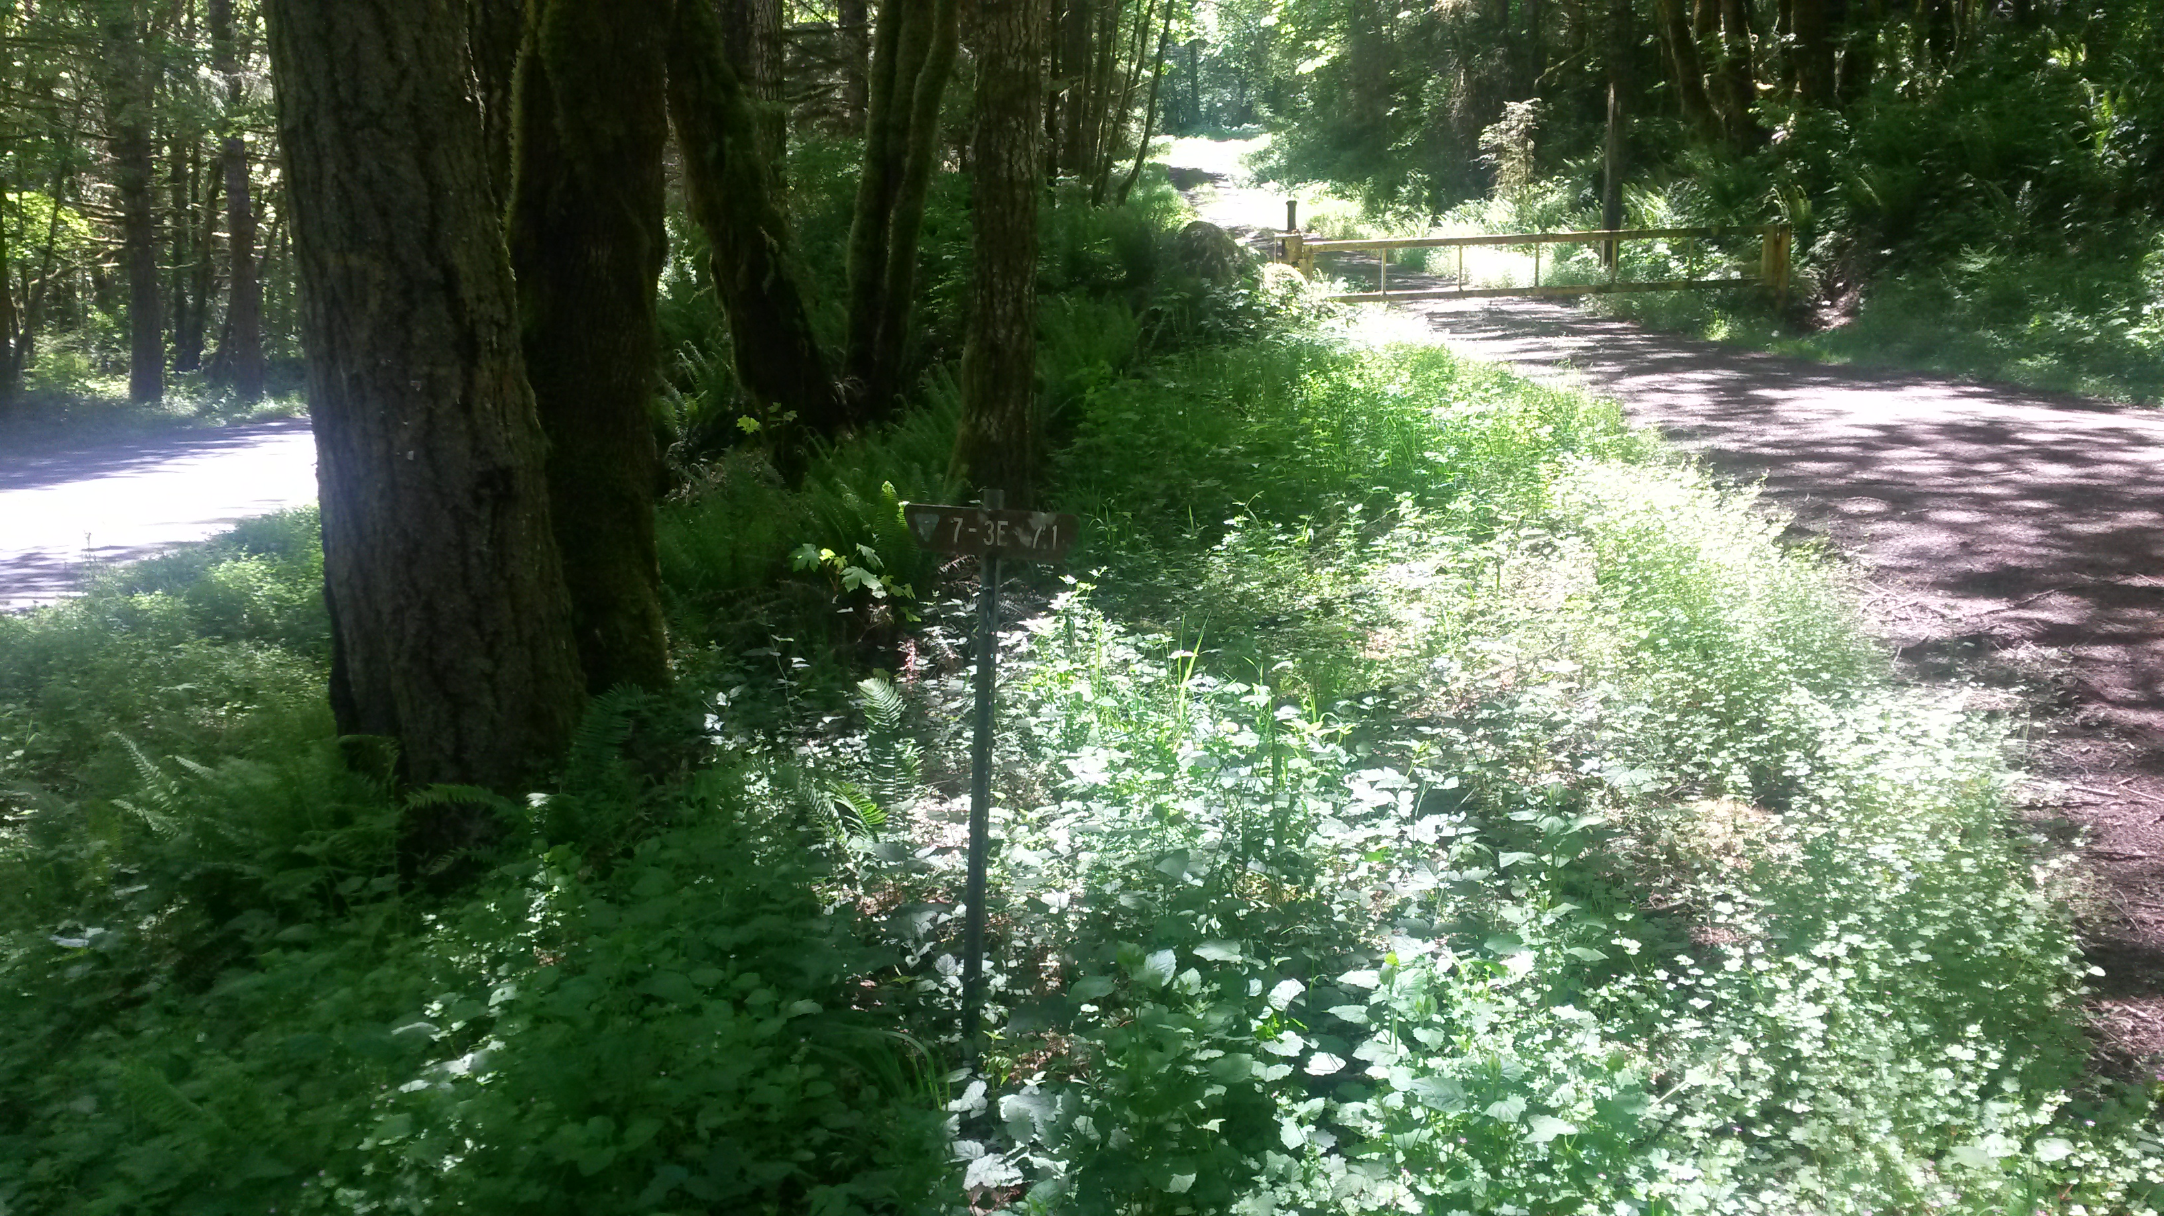
Events/Training Upcoming
HF Campout - Molalla
  July 28th – 30th
Aquila Vista Study Area (Waaaaaay Up the Mollalla River in BLM land)

Slide 12
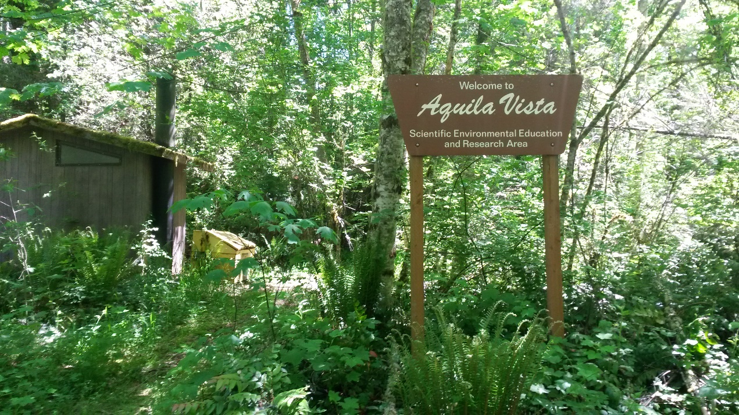
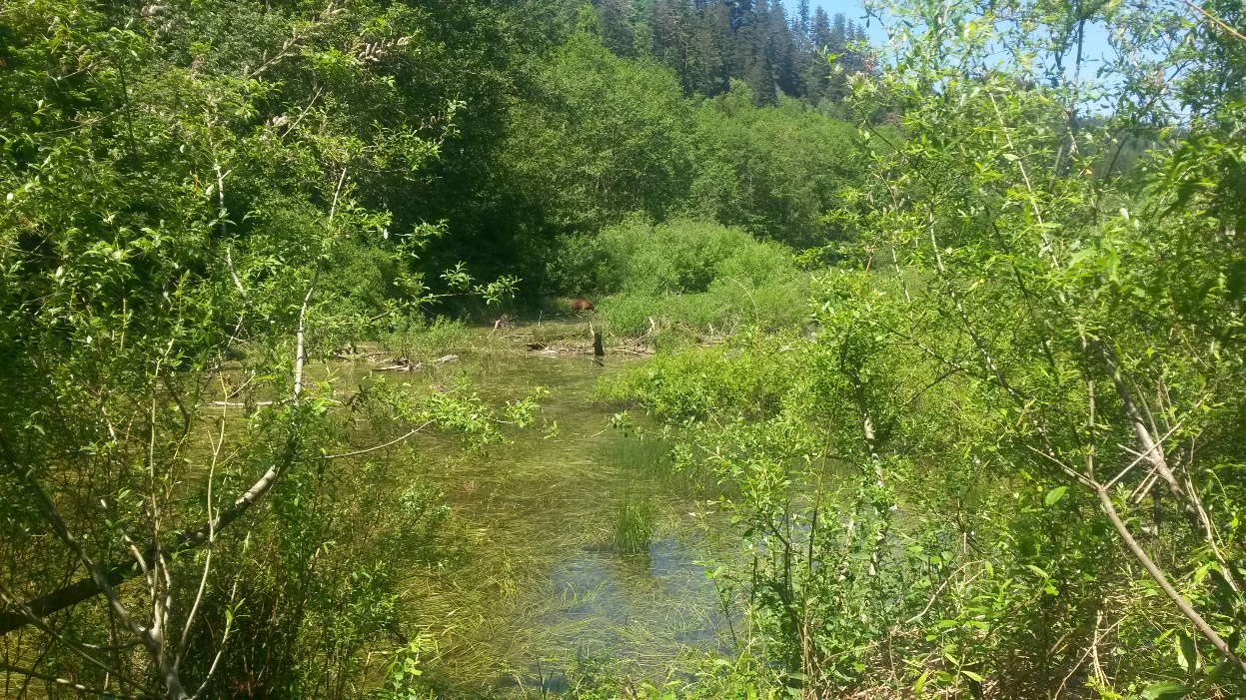
Events/Training Upcoming
HF Campout - Molalla
  July 28th – 30th

Slide 13
Raffle

Slide 14


Other Announcements?

