Slide 1


Multnomah County ARES
August 2017
MultnomahARES.org Leadership@multnomahARES.org

Slide 2

Welcome to the ARRL field unit for Multnomah County!
First Meeting? Please introduce yourself!
Please sign the attendance sheet.
Photo: Robert Anglin

Slide 3

Leadership Team
Emergency Coordinator: Nathan Hersey N9VCU
Assistant EC: Adam Karol KF7LJH
Assistant EC: Robert Anglin WX5TEX
Assistant EC: Deb Provo KK7DEB
Training Manager: Eli Pride W7ELI
Net Manager: Marino Duregon KG7EMV
Web Master: Brian Cochrane KE7QPV
PIO: Steve Hall W7RSH
Photo: Robert Anglin

Slide 4

Team Leaders
A- Robert Anglin
B- Matthew Bradburn
C- Steve Hall
D- Nate Hersey
E- Eli Pride
M-Adam Karol

Slide 5
Regular Meetings and Nets
Clubs are where you can get ham stuff we don’t teach or drill!!!!
  PARC: Fourth Friday of the Month, 7:30pm at Liberty Centre Building (W7LT.org)
  HARC: Third Thursday of the Month, 7:30pm MHCC Rm 1001 (WB7QIW.org)
Digital Modes Training Net - first Tuesday of each month 8PM, 443.300 (100 Hz tone)
THTN: 2nd and 4th Tues, 8:00 P.M. 147.180 (PL tone103.5)
ARES net: Wednesdays 7:00pm on 146.840
Neighborhood Emerg. Comms Training net (NECTN): Sundays 8:00pm on 443.3 (+, 100Hz)

Slide 6

Agenda
Leadership Updates
Events Completed
Events Upcoming
Training

Slide 7
Leadership updates
Contact Leadership
  Leadership@multnomahares.org
  New Folks Q&A @ 6:15 prior to the meeting
State activity for Eclipse – Doug Jimenez et al.
August Multnomah Report – 83 Members / 233 Hours for July
PBEM training
UASI Repeater Funds
Packet Gateway Work

Slide 8
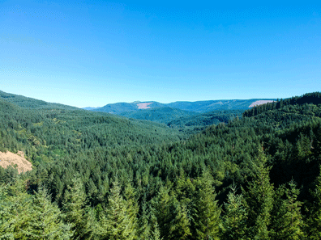
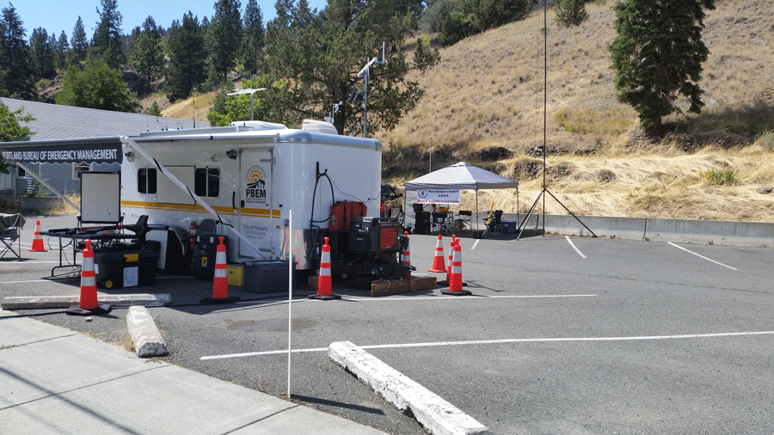
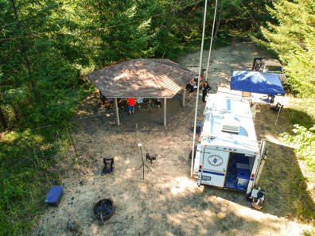
Events Completed
HF Campout
Charlie Mike Team Drill
Grant County Training

Slide 9
Events/Training Upcoming
Gresham Get Ready – 9/17
Hillsboro Air Show – 9/22 – 9/24
Marathon – 10/8
Tech Classes Sept 16th / 17th
Tech Classes (YL) Oct 12th through 21st
Rickreall 10/21

Slide 10


Other Announcements?

