Slide 1
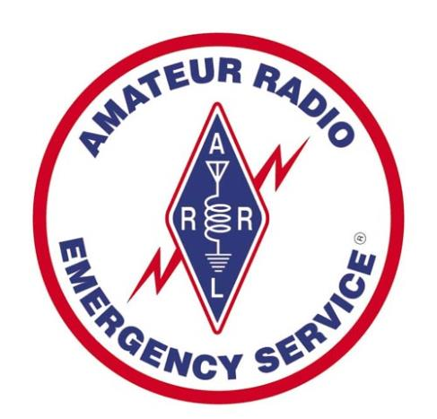

Multnomah County ARES
September 2017
MultnomahARES.org Leadership@multnomahARES.org

Slide 2
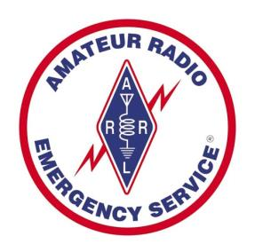
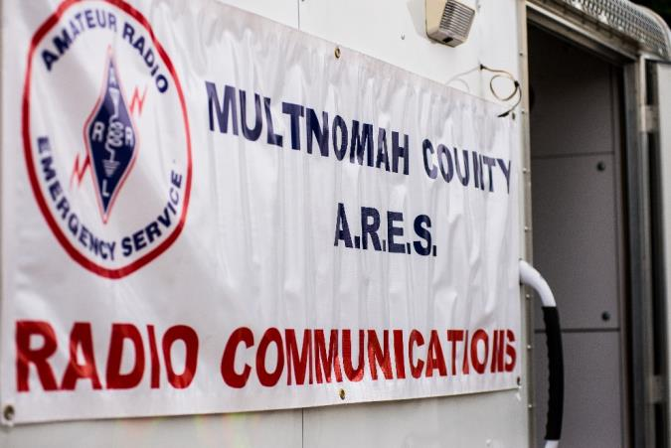
Welcome to the ARRL field unit for Multnomah County!
First Meeting? Please introduce yourself!
Please sign the attendance sheet.
Photo: Robert Anglin

Slide 3
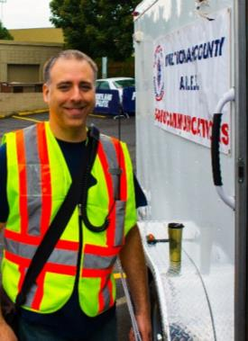
Leadership Team
Emergency Coordinator: Nathan Hersey N9VCU
Assistant EC: Adam Karol KF7LJH
Assistant EC: Robert Anglin WX5TEX
Assistant EC: Deb Provo KK7DEB
Training Manager: Eli Pride W7ELI
Net Manager: Marino Duregon KG7EMV
Web Master: Brian Cochrane KE7QPV
PIO: Steve Hall W7RSH
Photo: Robert Anglin

Slide 4

Team Leaders
A- Robert Anglin
B- Matthew Bradburn
C- Steve Hall
D- Nate Hersey
E- Eli Pride
M-Adam Karol

Slide 5
Regular Meetings and Nets
Clubs are where you can get ham stuff we don’t teach or drill!!!!
  PARC: Fourth Friday of the Month, 7:30pm at Liberty Centre Building (W7LT.org)
  HARC: Third Thursday of the Month, 7:30pm MHCC Rm 1001 (WB7QIW.org)
Digital Modes Training Net - first Tuesday of each month 8PM, 443.300 (100 Hz tone)
THTN: 2nd and 4th Tues, 8:00 P.M. 147.180 (PL tone103.5)
ARES net: Wednesdays 7:00pm on 146.840
Neighborhood Emerg. Comms Training net (NECTN): Sundays 8:10pm on 147.040(+, 100Hz)

Slide 6

Agenda
Leadership Updates
Events Completed
Events Upcoming
Training

Slide 7
Leadership updates
Contact Leadership
  Leadership@multnomahares.org
  New Folks Q&A @ 6:15 prior to the meeting
Multnomah EC Report – 85(+2) Members / 288 Hours for August
UASI Grant Funds
VHF Gateways

Slide 8
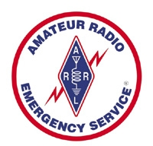
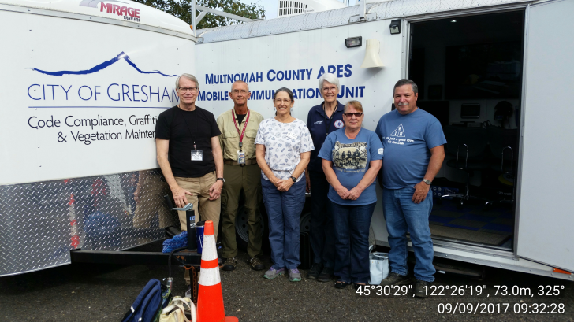
Events Completed
Sept 9th Team Drill
Eagle Creek Activation
Go Kit Build
Air Show
Gresham Get Ready

Slide 9
Events/Training Upcoming
Marathon – 10/8
  Volunteers Needed – Please Contact Pete w7pr@juno.com
Fall Oregon Section SET
  Operators Needed – Contact leadership@multnomahares.org
Tech Classes (YL) Oct 12th through 21st
Rickreall 10/21

Slide 10
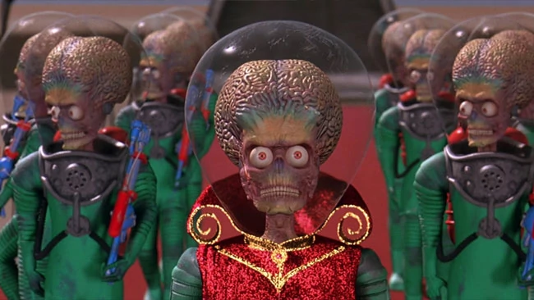
Mars Attacks
OCT 14th 0800 to 1500
Contest Style – Multiple Modes
Three Stations
  N9VCU
  K7MCE
  N7MCU

Slide 11
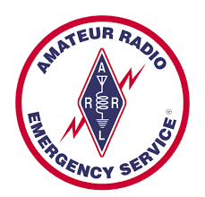

Other Announcements?

Slide 12
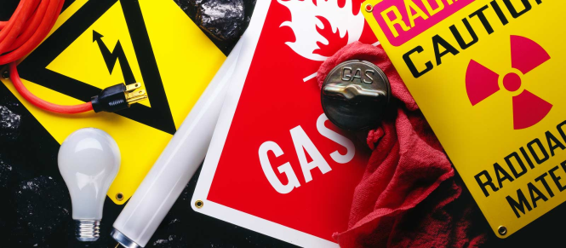
Safety for you and me!
PPE
MPE
NFPA 70E
PPM CO
P=IE

Slide 13
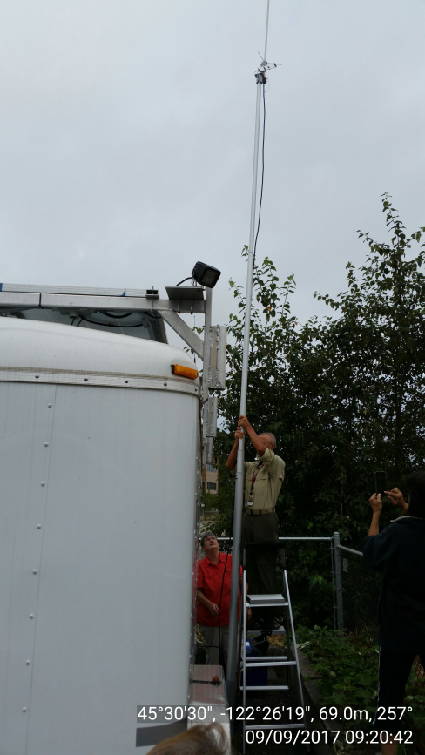
What’s the most dangerous activity for a field radio unit?
2016 – Experience climber falls from tower
2009 – 3 dead from electrocution while erecting new antenna

Slide 14
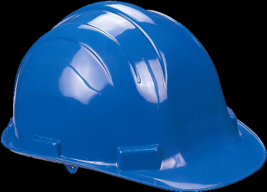
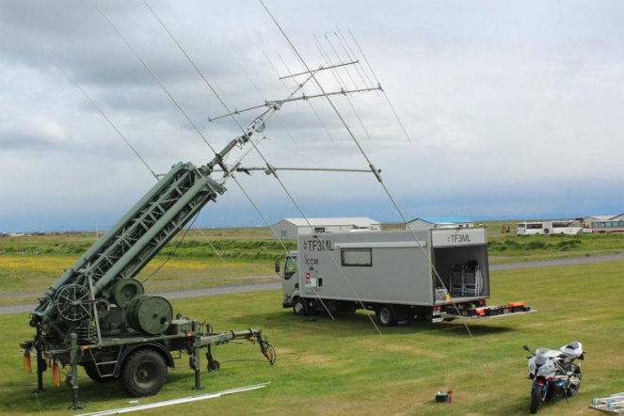
Antenna Safety
Clear Area When using launcher
Glasses when using compressed air
Clear of overhead lines
Load limitations and guying
PPE when erecting masts
  Glasses
  Hardhats
  Gloves

Slide 15
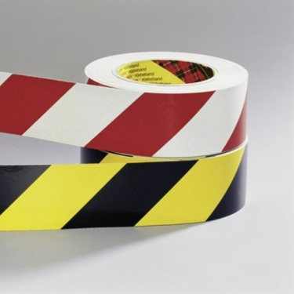
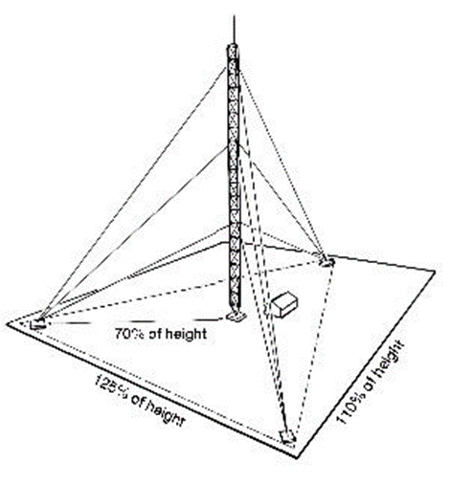
Antenna Safety Example
Guy angles
  ½ way up and 45 Degrees outward angle
  Other angle and placement options
If my guy is half way up my 20 foot mast what is the distance for 45 degree guy away from foot?
Anchoring Options
  Helical augers
  Permanent installs demand engineered solution

Slide 16
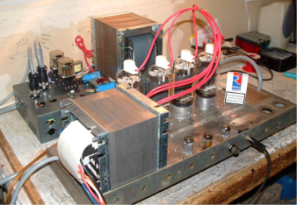
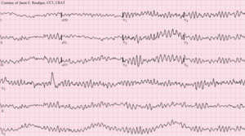
Live Electrical
I’ll spare you the electrical burn photos, but they’re gory
Above 24V you can start to feel it
Risk Minimization and Control
  De-Energize
  Clothing and Jewelry
  Test Equipment condition
Fire Extin. Class for Electrical?

Slide 17
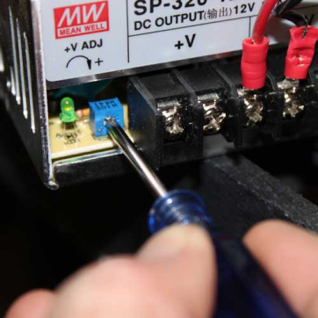
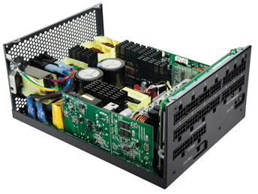
Example on the bench
Nate has added a PWRgate to his home station so he can float his battery off of his power supply
  Float Voltage is 13.4V
  Supply was shipped adjusted to 13.2V
  Drop Across diode is .7V (West Mountain lies)
  What do I do?
    Connect meter leads de-energized
    Secure and allow capacitors to discharge between adjustments
    Make adjustments and restore cover prior to checking new voltage

Slide 18
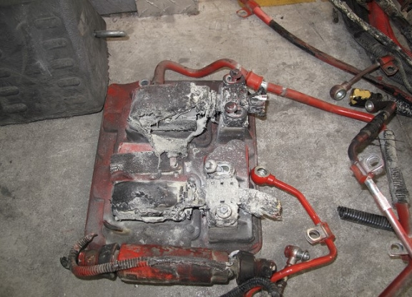
Shorts and over current protection

Slide 19
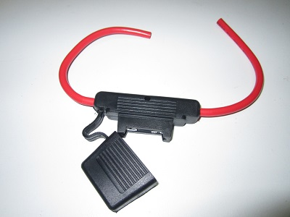
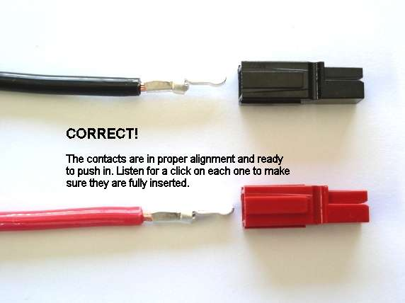
Shorts and over current protection
Your 50W radio has arrived Let’s hook it up…
  Fuses
    Fast Acting
    4 Amps for the RF out
    2 Amps for the lost to run the radio
    Manufacturer states 12 amp fuse
  Power Poles
    15A / 30A / 45A
  Stranded 10 Guage (>15A)
  Fuse before conductor
  Which fuse should clear?
    Fault side (load)

Slide 20
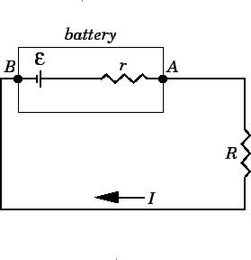
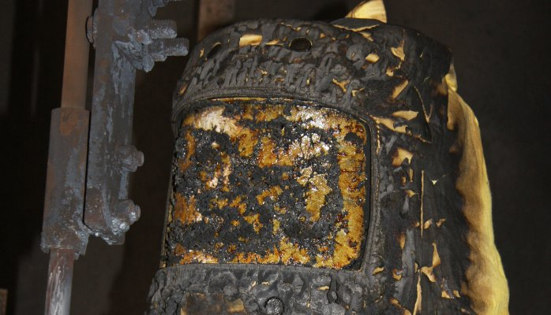
Shorts and over current protection
A quick calculation
  Nate is checking torque on a 240Vdc battery system
  Unbeknownst to him, the insulation has rubbed off his ratchet
  He creates a direct short between ten batteries in series
How much current flows through the ratchet?

Slide 21
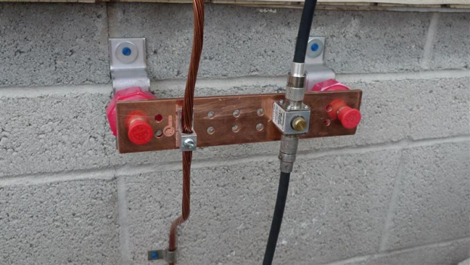
Grounding
Safety Ground
  Chassis Shorts
    Off the shelf Equipment?
    Household Electrical to code?
    Fuses Sized per Manufacturer?
  “Stray” RF
    Braid
    Chokes (Ferrite)
RF Ground
  Antennas are two halves
  Impedance at RF Freqs will be different than resistance to DC
Lightning Protection
  You must secure from operation (leave the station) in an electrical storm
  Protection systems are in depth and not guarantees
    Entire permanent station must be considered as a system
    Protection will require grounding to dissipate energy away from station

Slide 22
Radiation and You!
Maximum Permissible Exposure (MPE)
  RF is Non-Ionizing Radiation, so heat and burns are the issue in your tissue
As frequency increases, risk increases
Station Evaluations (bulletin 65)
  Based on Power
  Performed in multiple ways
    Measurements
    Models
    Tables

Slide 23
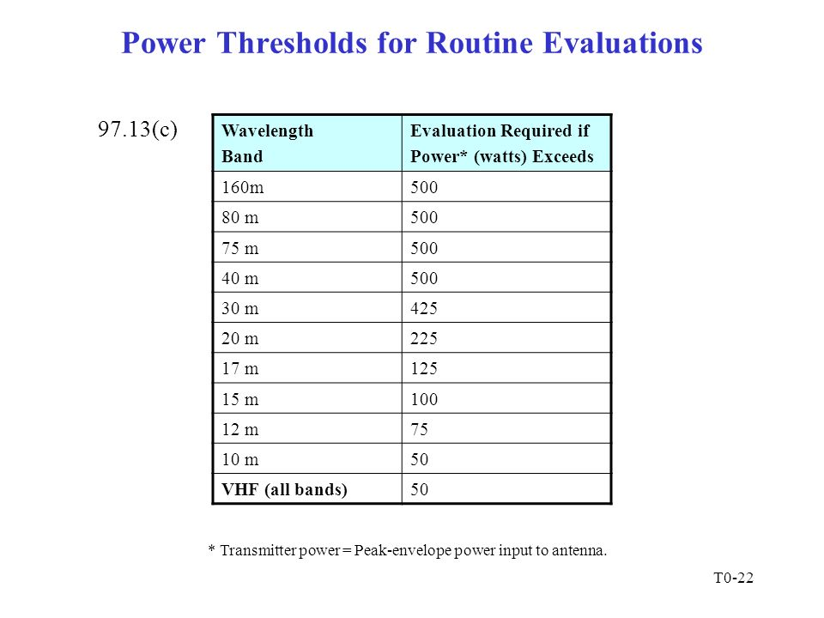

Slide 24
Tables www.arrl.org/fcc-rf-exposure-regulations-the-station-evaluation
But wait, isn’t heating exposure a risk over time? Why is that table in PEP ???
Duty Cycle
  Based On Operating Mode (ex. FM = 100%, SSB = 40%)
Exposure Type
  Controlled = Ham in the Shack
    6 min per hour exposure assumption
  Uncontrolled = Neighbor’s bratty kid
    30 minutes playing b-ball under you tower
Antenna Gain
  dBi / dBd
    Dipole 2.15 dBi (how Many dBd?)
    3 Element Beam 7.2 dBi

Slide 25
Table 4 of ARRL / W5YI effort
http://www.arrl.org/files/file/Technology/tis/info/pdf/Table4567.pdf
2m Band / FM / 50 Watts / Cont. / 5elt Yagi
  9.3m away from operator
20m Band / Digital / 100W / Uncontrolled / Dipole
  7.1m away from bystanders

Slide 26
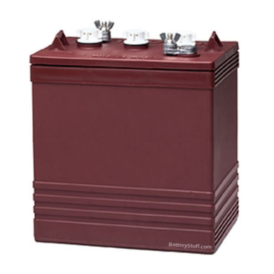
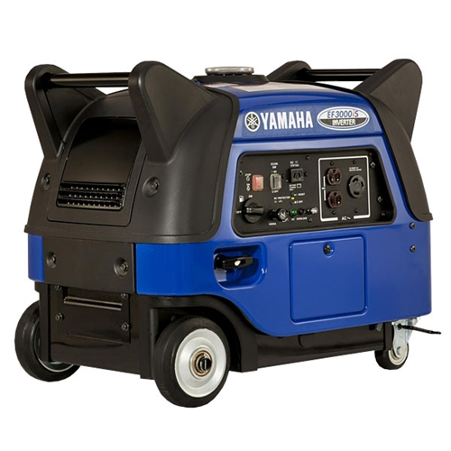
Ventilation
CO
  4 hour half life of Carbon Monoxide poison from blood
    Symptoms similar to dehydration
H2
  Hydrolysis of water when high I
    Boom

Slide 27

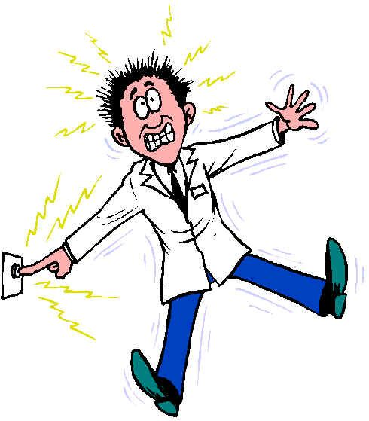
Questions?

