Slide 1

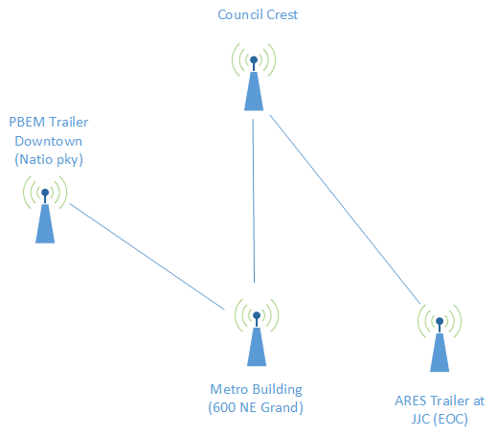
Multnomah County ARES
November 2017
MultnomahARES.org Leadership@multnomahARES.org

Slide 2
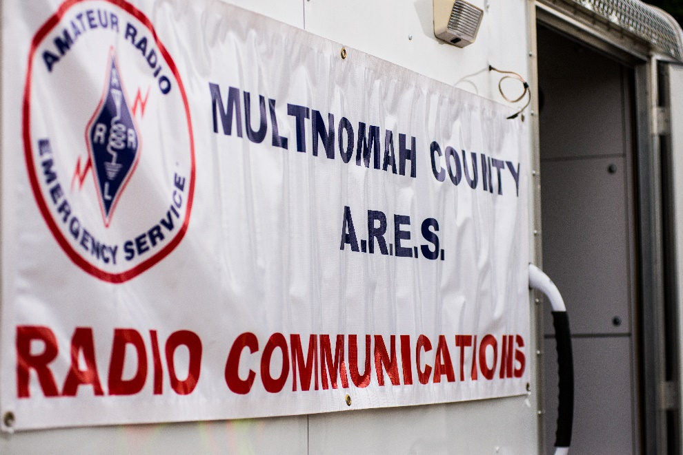
Welcome to the ARRL field unit for Multnomah County!
First Meeting? Please introduce yourself!
Please sign the attendance sheet.
Photo: Robert Anglin

Slide 3
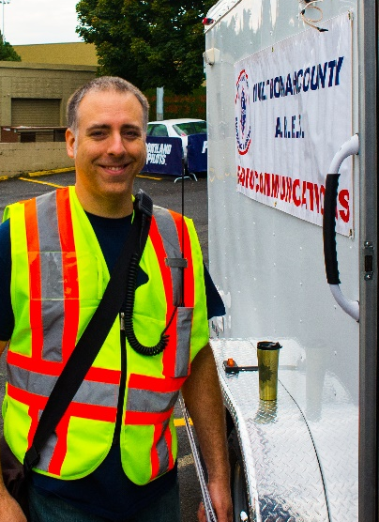
Leadership Team
Emergency Coordinator: Nathan Hersey N9VCU
Assistant EC: Adam Karol KF7LJH
Assistant EC: Robert Anglin WX5TEX
Assistant EC: Deb Provo KK7DEB
Training Manager: John Underwood KI7LYP
Net Manager: Open!
Web Master: Brian Cochrane KE7QPV
PIO: Steve Hall W7RSH
Photo: Robert Anglin

Slide 4
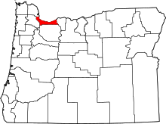
Team Leaders
A- Robert Anglin
B- Matthew Bradburn
C- Steve Hall
D- Nate Hersey
E- Eli Pride
M-Adam Karol

Slide 5
Regular Meetings and Nets
Clubs are where you can get ham stuff we don’t teach or drill!!!!
  PARCSecond Monday of the Month, 7:30pm at Central Northeast Neighbors Bldg
  HARC: Third Thursday of the Month, 7:30pm MHCC Rm 1001 (WB7QIW.org)
Digital Modes Training Net - first Tuesday of each month 8PM, 443.300 (100 Hz tone)
THTN: 2nd and 4th Tues, 8:00 P.M. 147.180 (PL tone103.5) (change coming)
ARES net: Wednesdays 7:00pm on 146.840
Neighborhood Emerg. Comms Training net (NECTN): Sundays 8:10pm on 147.040(+, 100Hz)

Slide 6
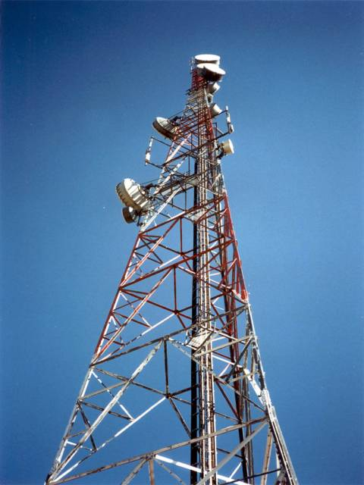
Agenda
Leadership Updates
Events Completed
Events Upcoming
Training
  Jpole instruction page – On Web

Slide 7
Leadership updates
Contact Leadership
  Leadership@multnomahares.org
  All Folks Q&A @ 6:15 prior to the meeting
NO Dec General Membership Mtg!!!
Multnomah EC Report – 93(+5) Members / 283 Hours for October
Membership Survey
Go-Kit Training for Mercy Corps
County Cards - Fingerprints

Slide 8

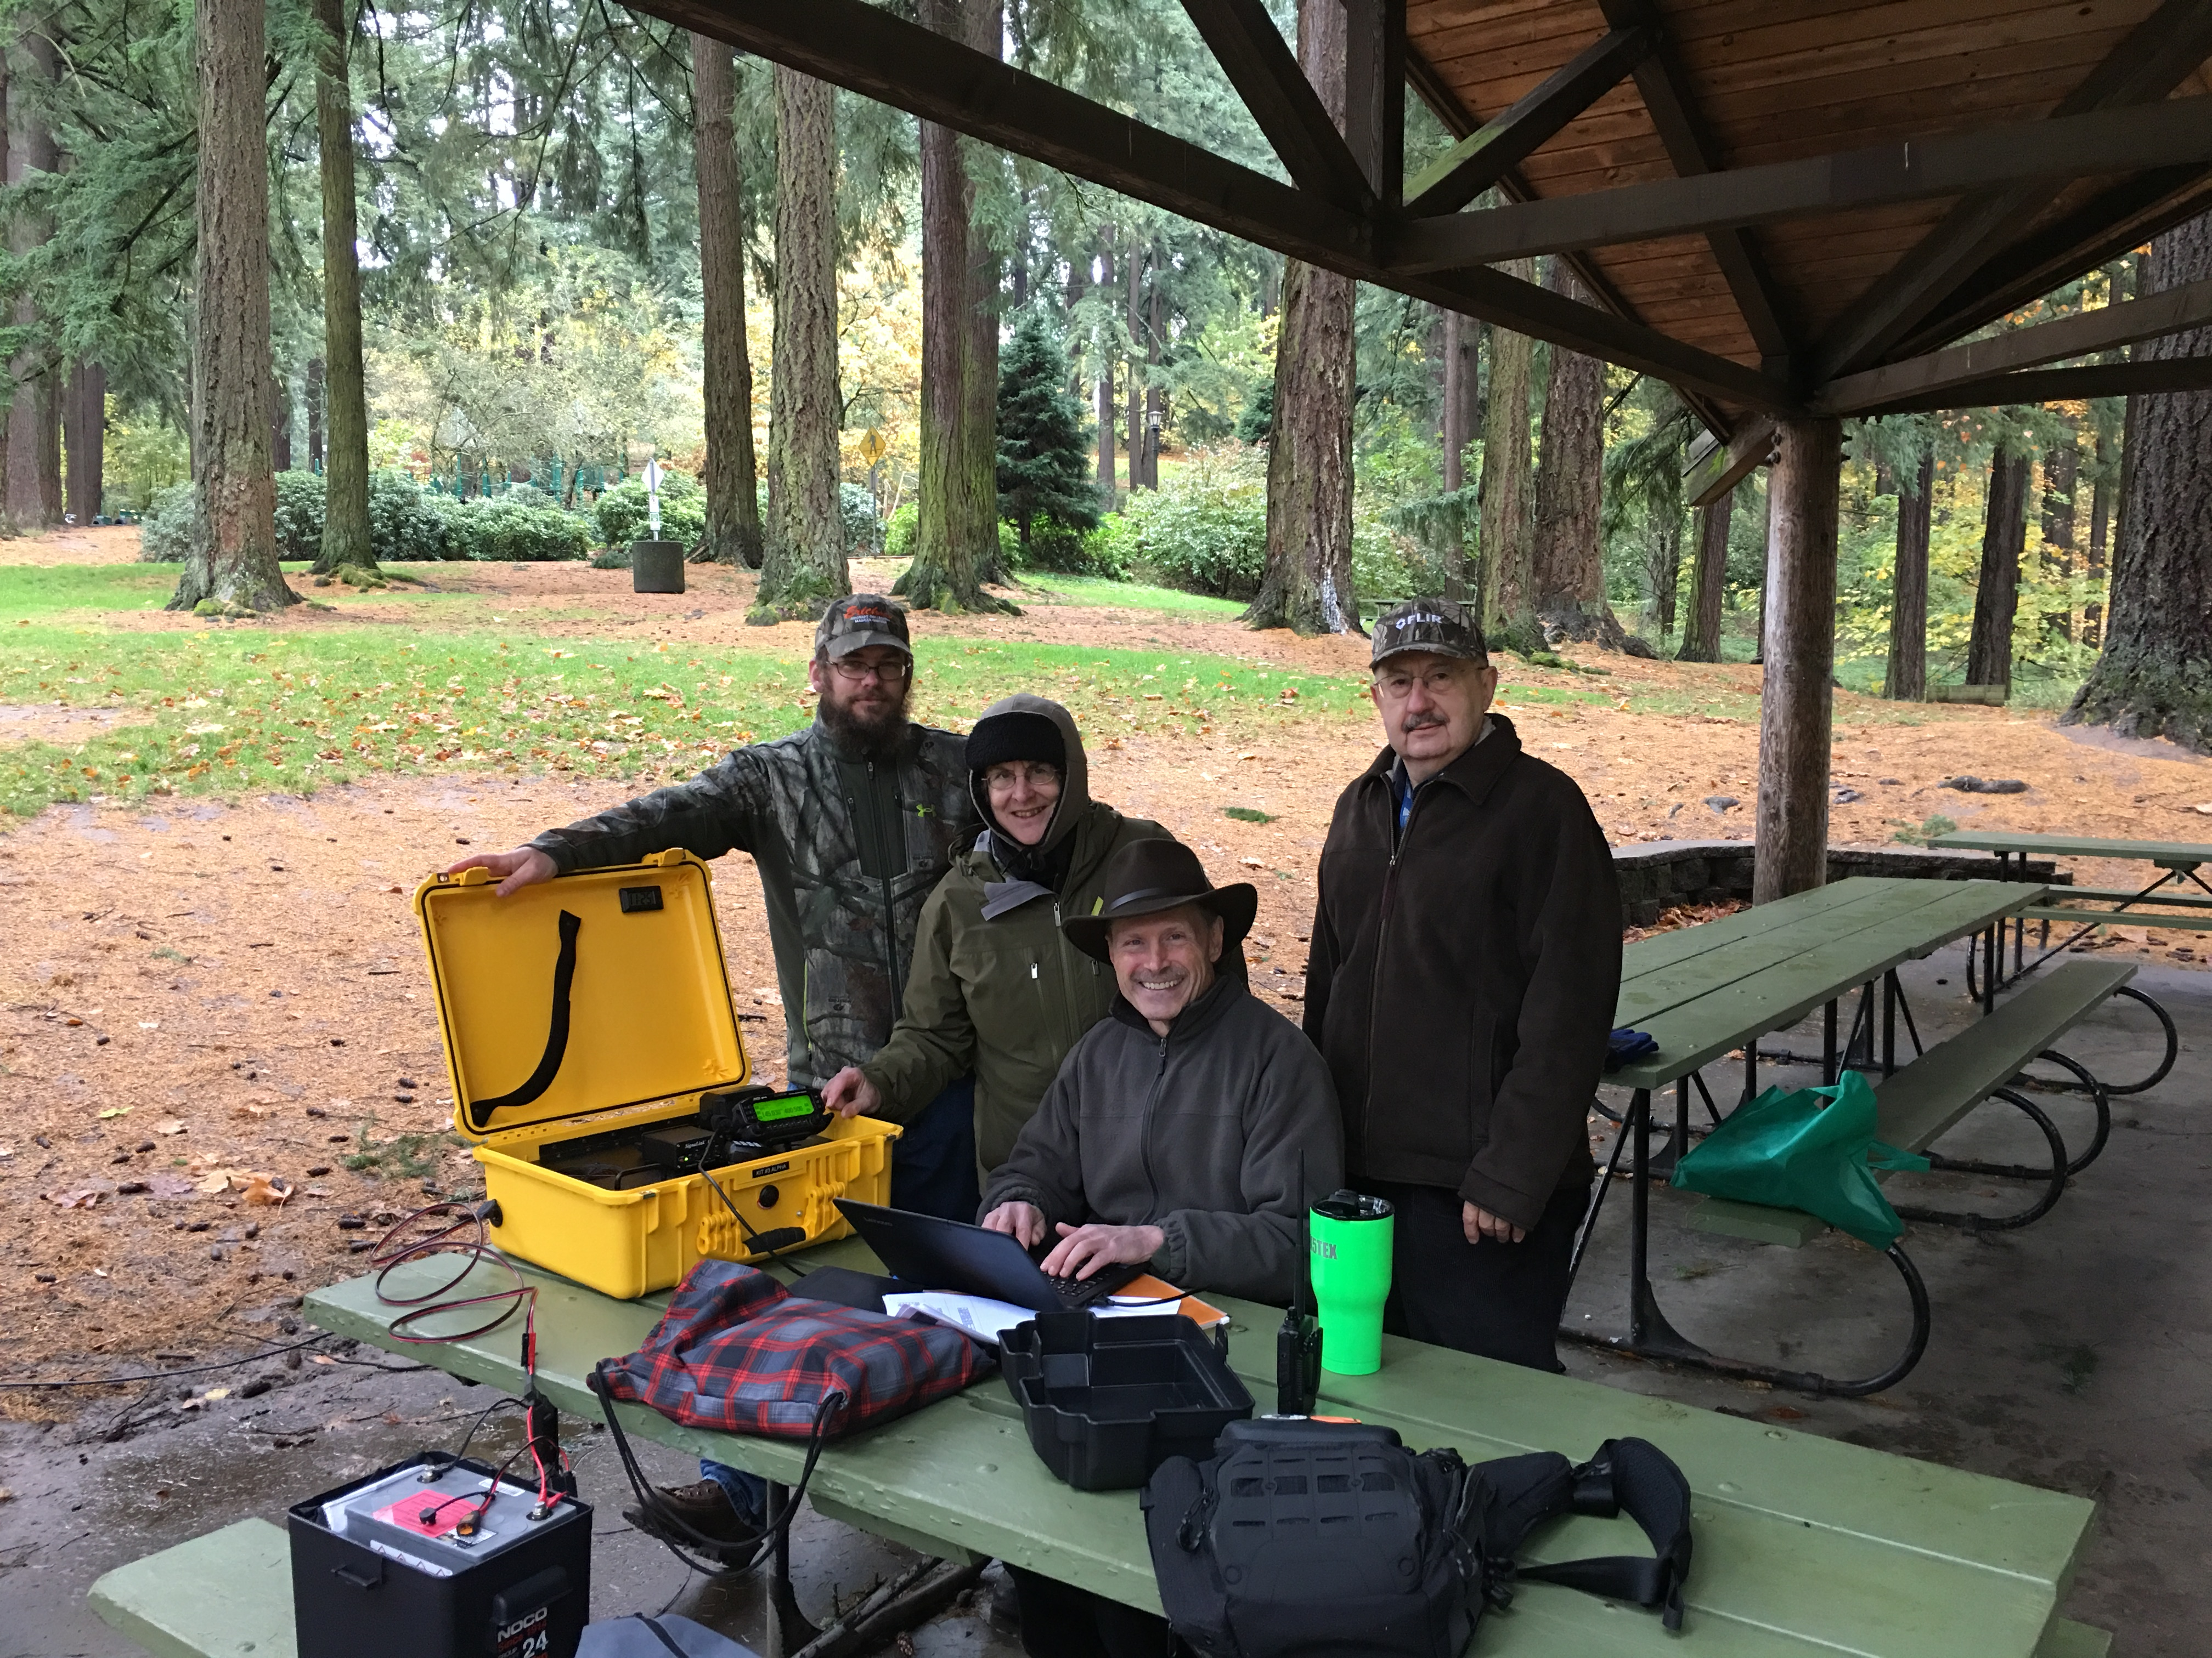
Events Completed
BEECN – Oct 29th
Delta/Alpha Team Drill
60M Interop w/DOD

Slide 9
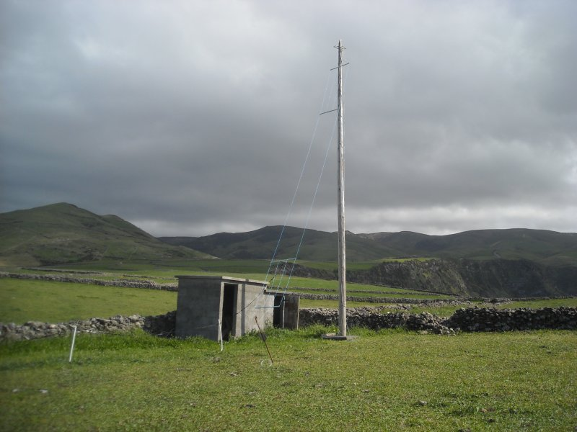
Events/Training Upcoming
Field Operations Dec 2nd
  Winlink Training
    Pier Park
  SkyWarn Appreciation Day
    Delta Team Encouraged
    MCARES invited
    Pier Park
    1300 until…
Alpha Team Year end
  Dec 7th at 7pm
  RSVP with ROBERT!!!!

Slide 10


Other Announcements?

