Slide 1

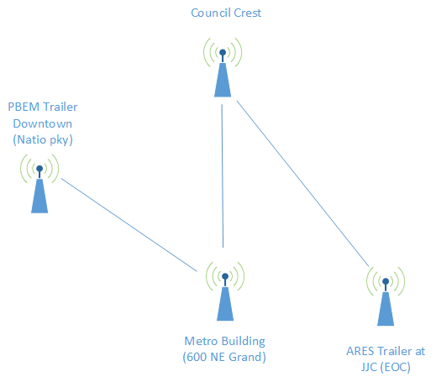
Multnomah County ARES
March 2018
MultnomahARES.org Leadership@multnomahARES.org

Slide 2
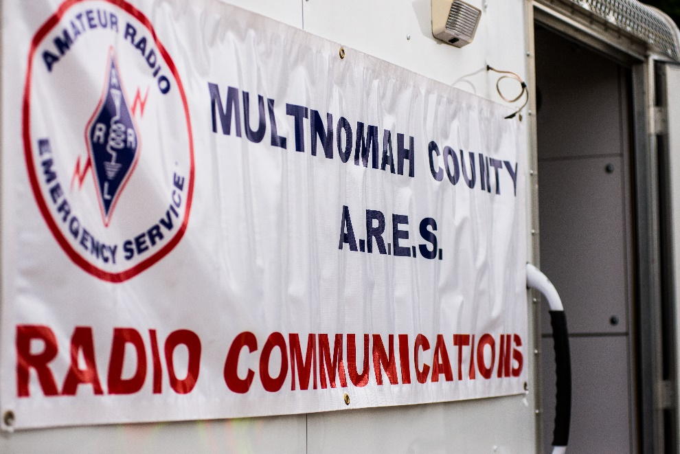
Welcome to the ARRL field unit for Multnomah County!
First Meeting? Please introduce yourself!
Please sign the attendance sheet.
Photo: Robert Anglin

Slide 3
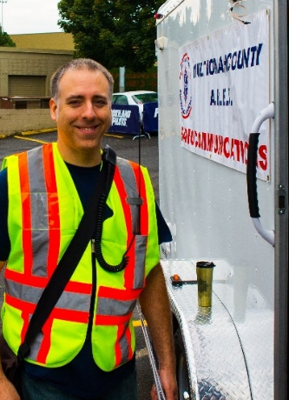
Leadership Team
Emergency Coordinator: Nathan Hersey N9VCU
Assistant EC: Adam Karol KF7LJH
Assistant EC: Robert Anglin WX5TEX
Assistant EC: Deb Provo KK7DEB
Training Manager: John Underwood KI7LYP
Net Manager: Rachel Stout KI7NMB
Net Content Coordinator: Patti U KB7GMM
Web Master: Brian Cochrane KE7QPV
PIO: Steve Hall W7RSH
Photo: Robert Anglin

Slide 4
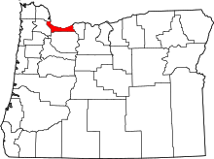
Team Leaders
A- Robert Anglin
B- Emily Newberry
C- Carrie Conte
D- Nate Hersey
E- Eli Pride
M-Adam Karol

Slide 5
Regular Meetings and Nets
Clubs are where you can get ham stuff we don’t teach or drill!!!!
  PARC: Second Monday of the Month, 7:30pm at Central Northeast Neighbors Bldg
  HARC: Third Thursday of the Month, 7:30pm MHCC Rm 1001 (WB7QIW.org)
Digital Modes Training Net - first Tuesday of each month 8PM, 443.300 (100 Hz tone)
THTN: 4th Tues, 8:00 P.M. 146.840
ARES net: Wednesdays 7:00pm on 146.840 except Second Wednesday!!! (Simplex or Temp Infrastructure)
Neighborhood Emerg. Comms Training net (NECTN): Sundays 8:10pm on 147.040(+, 100Hz)

Slide 6
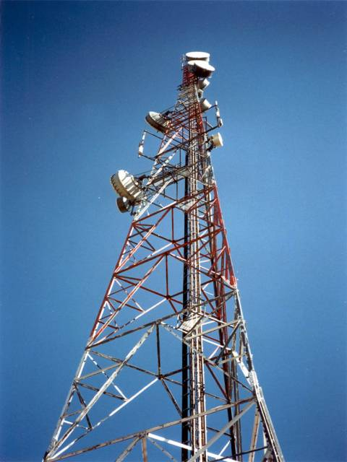
Agenda
Leadership Updates
Events Completed
Events Upcoming
Training
  Antennas

Slide 7
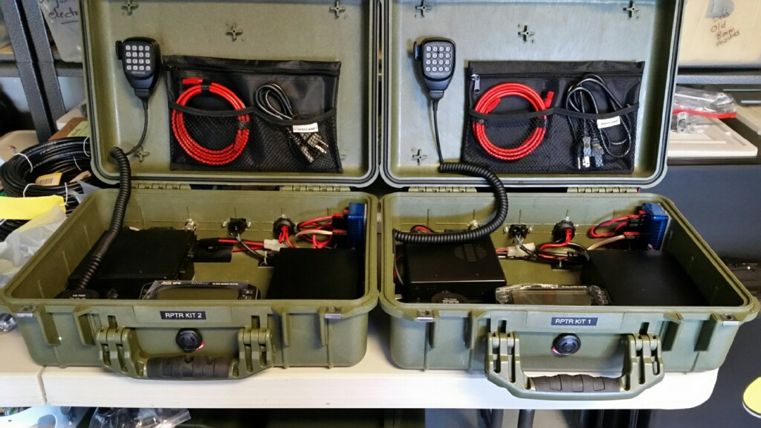
Leadership updates
Contact Leadership
  Leadership@multnomahares.org
  All Folks Q&A @ 6:15 prior to the meeting
Facebook.com/MultnomahARES
Instagram: @MultnomahARES
MC EC Report – 90(+1) Members / 273.5 Hours for December
Field Day Permit
Portable repeater
Events Galore!!!

Slide 8

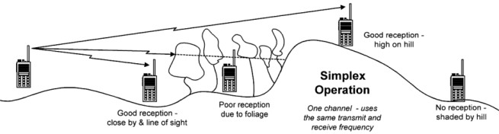
Events Completed
Workshops
  Hardware
  Traffic
C/M Drill
Simplex Net

Slide 9
Events/Training Upcoming
Walk MS April 7th
OR Sect Spring SET April 14th 09-13
  Grid Cyber Attack
Cable Making Workshop April 28th
E/B Team Drill May 12th
Cars for a Cause May 13th

Slide 10
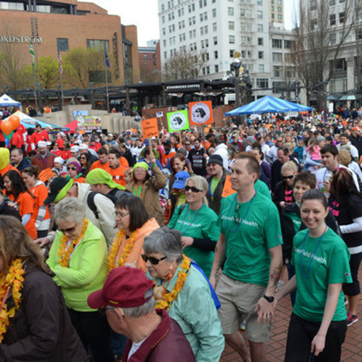
Walk MS April 7th 0800
Downtown Portland, Oregon
  3k walkers / 5km course
  The primary role of Multnomah County ARES (MCARES) in this event is to coordinate emergency response should an incident occur related to the event, and to keep event officials informed of the progress of walkers along the event route.
Volunteer Consent Forms!
Review 205 Freq Template in Volunteer Guide
Medical emergency? Emerg 911 then net control
SAG request -> net control

Slide 11

April SET Pre-Brief
Spring S.E.T Grid Cyber Attack
April 14th 0900 – 1300
Massive cyber-attack on the electrical grid in the Pacific Northwest; downstream impacts.
No internet or fixed repeaters

Slide 12
April SET Pre-Brief
Deployment bag review
  Each team member is to bring their deployment bag and will be checked off by your team leader.
Team org
Station | Team | Station Call | Notes
ECC at JJC | Alpha | K7MCE | Align K7MCE-10 for RMS Relay / Act and Deact to State
Field Repeater Team | Alpha | KF7ZWX | Set up 70cm portable repeater
SSTV Field Station | Bravo | N7EMH | Send VHF imagery from field to N7MCU, Surrounding counties if possible
L&C | Charlie 1 | K7CAC | HF State Voice Net monitor
Sylvania | Charlie 2 | WA7FWC | HF Soundcard modes to other counties
Sauvie | Delta | NA7EE | Ground Wave to Corbett
Corbett | Echo | W7ELI | Ground Wave to Sauvie / Resource Net
Net Control | Mike | N7MCU | Command Net

Slide 13
Operating Notes
All messages should be transmitted with “Exercise”
Antenna safety!
Resource net – MC5 (SIMPLEX)!
  Stations are asked to be at their deployed locations at 0900, and to check into net control from their deployed location / single check-out after drill
Command Net – Check Drill Guide – Freq may need to be programmed!!!
Shift Changeover - log swap

Slide 14

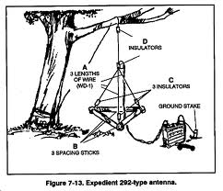
Expected Traffic
Winlink is better than voice, but no internet nodes!
Local delivery or PTP only
Voice traffic ok if necessary
Alpha Team –
  Activation / Deactivation to SALEM
Bravo Team
  Image to Trailer
Charlie
  Sitrep to Salem (Voice or Digi)
Delta/Echo Groundwave ICS 213
All Stations –
  Sit Rep to N7MCU
  ICS213 round robin

Slide 15


Other Announcements?

