Slide 1


Multnomah County ARES
March 2018
MultnomahARES.org Leadership@multnomahARES.org

Slide 2

Welcome to the ARRL field unit for Multnomah County!
First Meeting? Please introduce yourself!
Please sign the attendance sheet.
Photo: Robert Anglin

Slide 3

Leadership Team
Emergency Coordinator: Nathan Hersey N9VCU
Assistant EC: Adam Karol KF7LJH
Assistant EC: Robert Anglin WX5TEX
Assistant EC: Deb Provo KK7DEB
Training Manager: John Underwood KI7LYP
Net Manager: Rachel Stout KI7NMB
Net Content Coordinator: Patti U KB7GMM
Web Master: Brian Cochrane KE7QPV
PIO: Open
Photo: Robert Anglin

Slide 4

Team Leaders
A- Robert Anglin
B- Emily Newberry
C- Carrie Conte
D- Nate Hersey
E- Eli Pride
M-Adam Karol

Slide 5
Regular Meetings and Nets
Clubs are where you can get ham stuff we don’t teach or drill!!!!
  PARC: Second Monday of the Month, 7:30pm at Central Northeast Neighbors Bldg
  HARC: Third Thursday of the Month, 7:30pm MHCC Rm 1001 (WB7QIW.org)
Digital Modes Training Net - first Tuesday of each month 8PM, 443.300 (100 Hz tone)
THTN: 4th Tues, 8:00 P.M. 146.840
ARES net: Wednesdays 7:00pm on 146.840 except Second Wednesday!!! (Simplex or Temp Infrastructure)
Neighborhood Emerg. Comms Training net (NECTN): Sundays 8:10pm on 147.040(+, 100Hz)

Slide 6

Agenda
Leadership Updates
Events Completed
Events Upcoming
Training
  MMSSTV

Slide 7
Leadership updates
Contact Leadership
  Leadership@multnomahares.org
  All Folks Q&A @ 6:15 prior to the meeting
Facebook.com/MultnomahARES
Instagram: @MultnomahARES
MC EC Report – 93(+3) Members / 191 Hours for March
County Ask Update
PIO – Open Position, Thanks Steve!!!

Slide 8

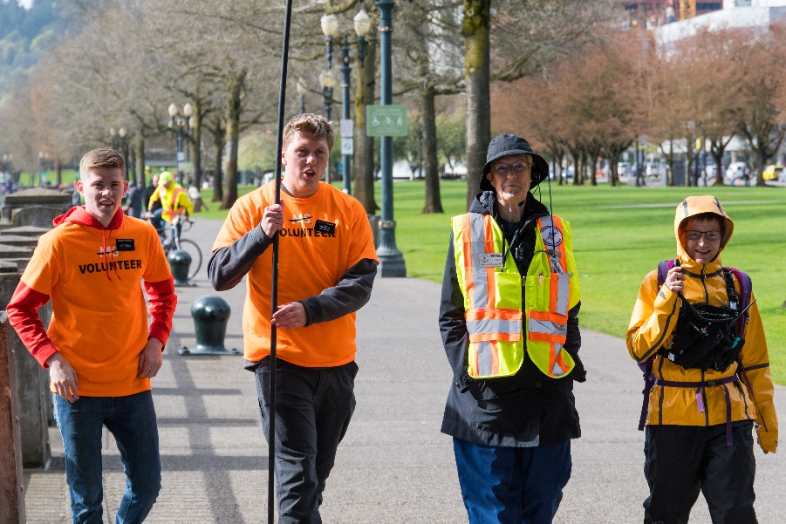
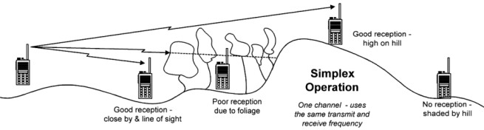
Events Completed
Walk MS
Spring SET
Simplex Net

Slide 9

Events/Training Upcoming
Cable Making Workshop April 28th
E/B Team Drill May 12th
Cars for a Cause May 13th
General License Class May5&12th
Field Day June 23rd/24th

Slide 10

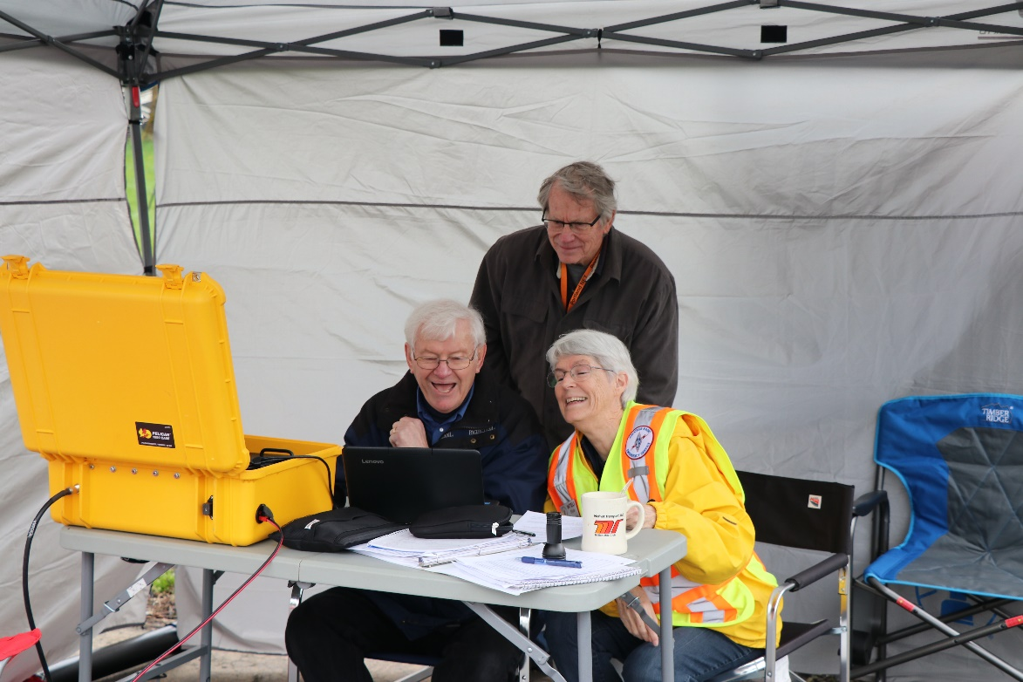
April SET AAR
Spring S.E.T Grid Cyber Attack
  52 Operators with 257 hours on SET day!
  All the teams operating

Slide 11
April SET AAR
  Alpha
    JJC – ICS-213 Traffic
    Logging
  Bravo
    PCC Southeast MMSSTV
    Go-Kit Manual review
    Freq transferring – Operating Multiple Modes
  Charlie
    Split at L&C and Field Station
    HF Voice and Digital at L&C
    Digital HF work from Field Station
    Freq transferring – Operating Multiple Modes

Slide 12
APRIL SET AAR
  Delta
    Sauvie Island Thanks to the SIFD Volunteers!
    HF on 6, 10 and 20m
    Crossband Linking – Needs work
  Echo
    Corbett Fire
    HF ops
    Interference and connectivity from Corbett
  Mike
    N7MCU
    Setup – Multiple masts for all needs
    Antenna interference

Slide 13

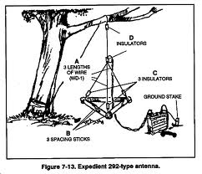
Overall
All stations had multiple operating challenges thrown at them
  In an actual emergency, equipment and operating will be kept as simple as possible
  Weather! Services!
Multiple great contacts made in unincorporated portions of the county
Potential for operating in lower bands?
Crossband repeater deployment
New team leader trials by fire!

Slide 14
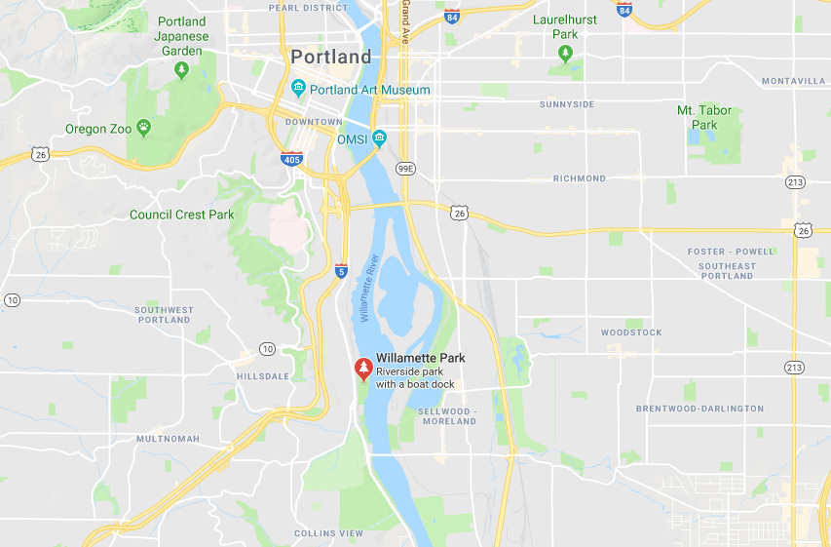
Field Day
Willamette Park (Picnic Shelter)

Slide 15
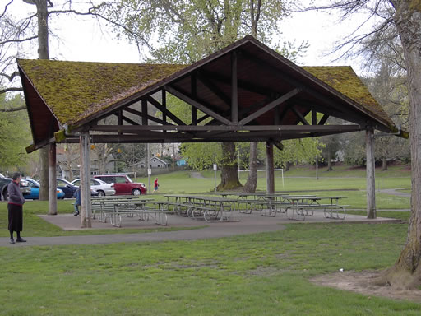
Location
Pros:
  Foot Traffic!!!
  River Views
  Picnic Shelter
  Heads! Shore Power?
Cons:
  No STAKES
  Neighbors
  Evening Security?
    Nate ain’t one to worry

Slide 16
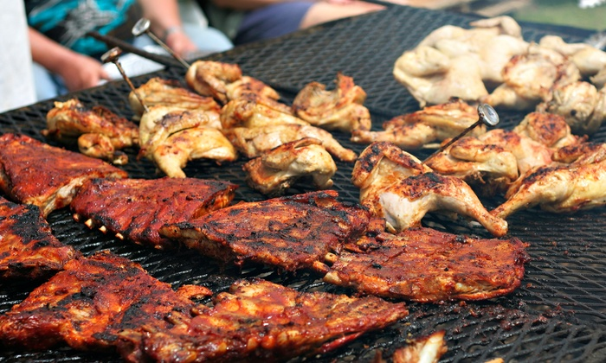
Tasks – Holy Moly!
On June 23rd ARES members and NET AROs will be operating, outreaching, and munching
In order to get there, we’ve got a big lift
We’ll be running 2 points stations, outreach station, info booth, kitchen…

Slide 17

Tasks – Holy Moly!
Pre-Day Outreach
  Most points are gained from outreach
  Rules Review
Outreach / GOTA station
  This location was chosen for foot traffic, so we’re going to need friendly, outgoing, knowledgeable operators at the ready!
Points Stations
  Antenna Thought
  CW Operators / FT8 Operators throughout the night
Food
Station Setup

Slide 18


Other Announcements?

Slide 19
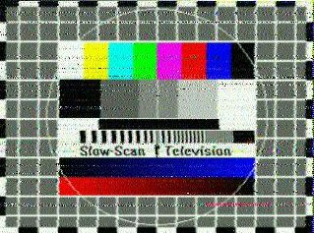
SSTV
A lot of good work has been done to determine the best still imagery mode
  For MCARES MMSSTV has been shaking out on top
Generally – Analog signal, modulating audio freq for pixel color, some pixels per line, some lines per image.

Slide 20


Applications
Every IC loves a picture!
Composition and Cropping
  Include needed references (zoom out to tell the story)
  Do not include unnecessary info (crop to minimize image size and transfer time
  The time it takes to transfer and handle an image is significant, try to make sure it’s worth it!
Try it out on HF!
  Leave your rig running in RX
    Make sure to disable system sounds

Slide 21
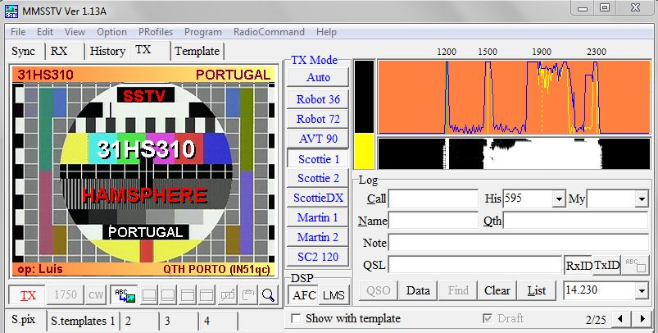
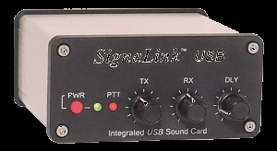
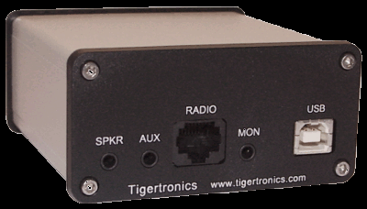
What’s Needed?
Hardware
  Transciever
    VHF/UHF
    HF
  Sound Card Interface
    Signalink or other – isolation, drive and rx control
Software
  MMSSTV

Slide 22
Setup
Software
  Selection of correct soundcard
  Internal Sound Card Gain
  Access through firewall?
Operating Mode
  Certainly not BFO
Drive
  Xcvr Gain
    May have separate gain for SSB, FM, Dig, Mic, Port

Slide 23
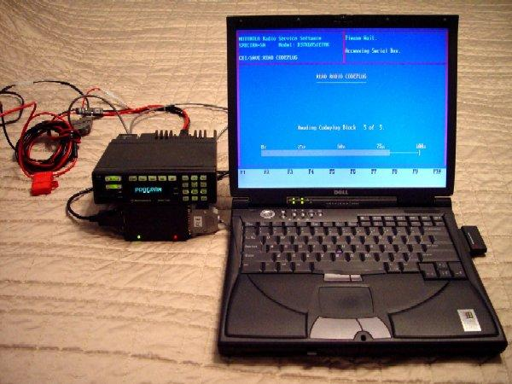
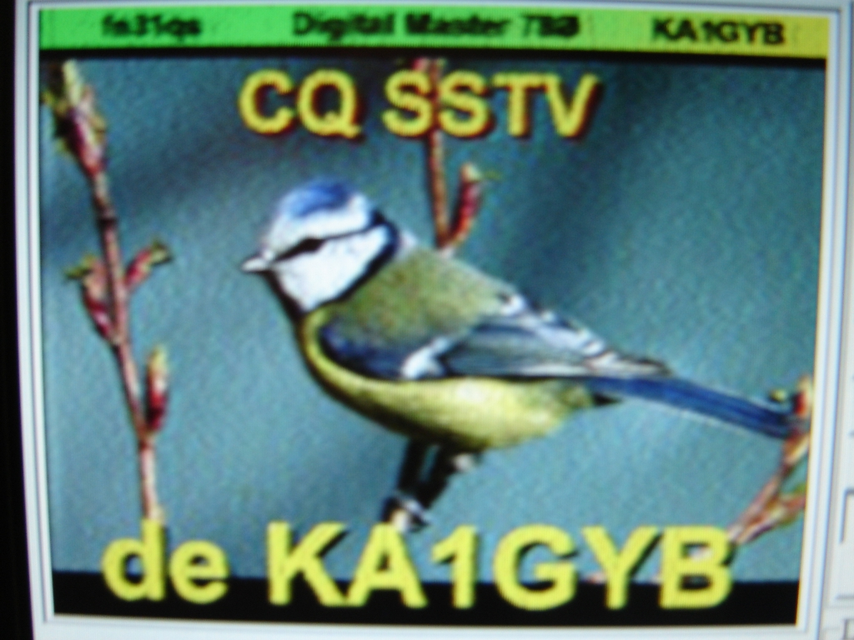
Alternative
Audio Coupling
  Ambient Noise effects signal quality
  We all know that operating locations are noisy!
Phone Apps
  Droid SSTV
  Robot 36?
  Black Cat (Apple)

Slide 24
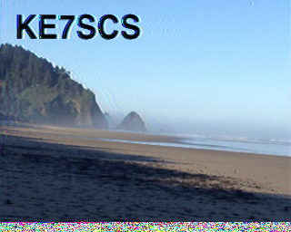
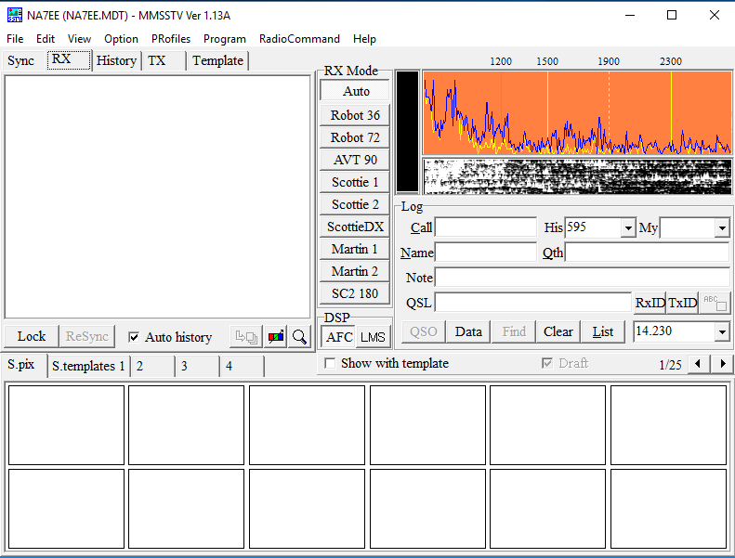
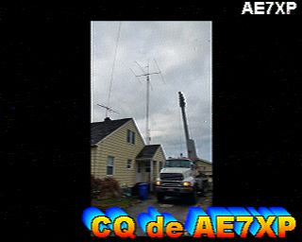
Operating the software
Modes
Image Prep
Transmission

Slide 25
Operating on a Net
Image Size
  Select image resolution for 2 minute transmit time
  Full Duty Cycle mode!!!
    Transmitter and repeater heat dissipation considerations
  Simplex Net?
    Note that transmission time is long and you may not be able to hear other side
    Controlled net? Potential to do image transmission on separate freq
  Lessons learned from Winlink from home are applicable here

Slide 26
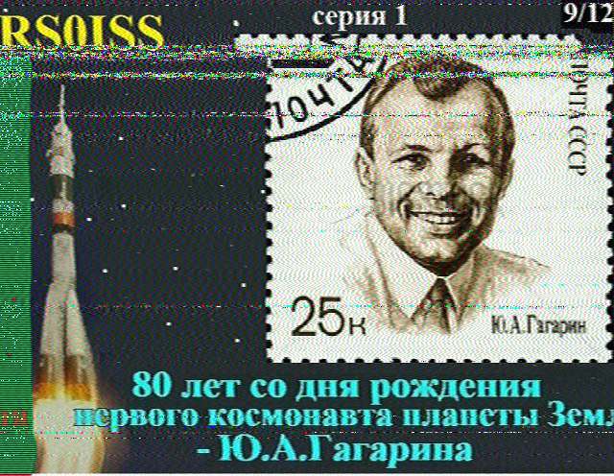
Results

Slide 27
Questions?

