Slide 1


Multnomah County ARES
May 2018
MultnomahARES.org Leadership@multnomahARES.org

Slide 2

Welcome to the ARRL field unit for Multnomah County!
First Meeting? Please introduce yourself!
Please sign the attendance sheet.
Photo: Robert Anglin

Slide 3

Leadership Team
Emergency Coordinator: Nate Hersey NA7EE
Assistant EC: Adam Karol KF7LJH
Assistant EC: Robert Anglin WX5TEX
Assistant EC: Deb Provo KK7DEB
Training Manager: John Underwood KI7LYP
Net Manager: Rachel Stout KI7NMB
Net Content Coordinator: Patti U KB7GMM
Web Master: Brian Cochrane KE7QPV
PIO: Open
Photo: Robert Anglin

Slide 4
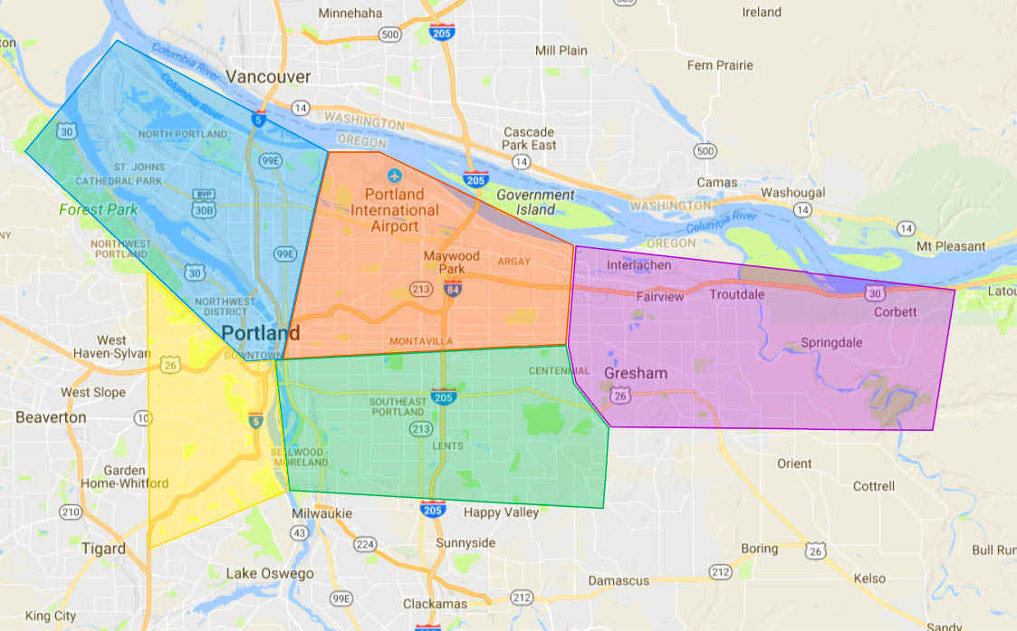
Team Leaders
A- Robert Anglin
B- Emily Newberry
C- Carrie Conte
D- Nate Hersey
E- Eli Pride
M-Adam Karol

Slide 5
Regular Meetings and Nets
Clubs are where you can get ham stuff we don’t teach or drill!!!!
  PARC: Second Monday of the Month, 7:30pm at Central Northeast Neighbors Bldg
  HARC: Third Thursday of the Month, 7:30pm MHCC Rm 1001 (WB7QIW.org)
Digital Modes Training Net - first Tuesday of each month 8PM, 443.300 (100 Hz tone)
THTN: 4th Tues, 8:00 P.M. 146.840
ARES net: Wednesdays 7:00pm on 146.840 except Second Wednesday!!! (Simplex or Temp Infrastructure)
Neighborhood Emerg. Comms Training net (NECTN): Sundays 8:10pm on 147.040(+, 100Hz)

Slide 6

Agenda
Leadership Updates
Events Completed
Events Upcoming
Training
  Voice Traffic

Slide 7
Leadership updates
Contact Leadership
  Leadership@multnomahares.org
  All Folks Q&A @ 6:15 prior to the meeting
Facebook.com/MultnomahARES
Instagram: @MultnomahARES
MC EC Report – 95(+3) Members / 419 Hours for March
County Purchase
PIO – Open Position in Multnomah
  Currently State Section PIO is KE7JSS John Sanders
Outreach to OEM for regional strategy

Slide 8
Sisters – State ARES Leadership Conference
Thanks to Tom Sharp running a tight ship!
Congratulations to Grant Co – SET Champs!
  Steve Fletcher to design Fall SET too…
New national ARES training program?
New SM/SEC – David Kidd KA7OZO
Emergent Volunteers
EM Relationship Building (Jamie Poole)
ESF-2 and ARES Sonya Andron
SHARES/FLDIGI/Winlink
Winlink to OEM? Try to include ESF

Slide 9
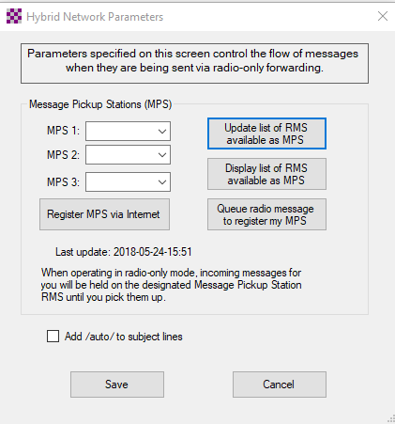
WINLINK – Operating Notes
Mail Pickup Station?
  Register location before the event!!!
ARDOP
  WL2K Crew’s winmor replacement
VARA?
  License fee…but no extra hardware
  VHF FM? still in testing
  Passband? Need 2800Hz of waterfall
  HF- Blistering fast
    like Pactor III if S/N is good
Pactor
  Still potentially the noise king

Slide 10

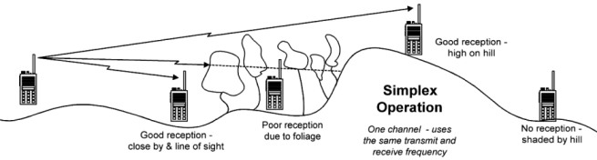
Events Completed
E/B Team Drill May 12th
Cars for a Cause May 13th

Slide 11

Events/Training Upcoming
Seapac – June 1-3rd
  Outreach
Hardware Workshop June 2nd
Team Drill June 9th
  Alpha Delta
Field Day June 23rd/24th
  Positions/Operating Rosters
HF Workshop July 7th

Slide 12


Other Announcements?

